Slide 1
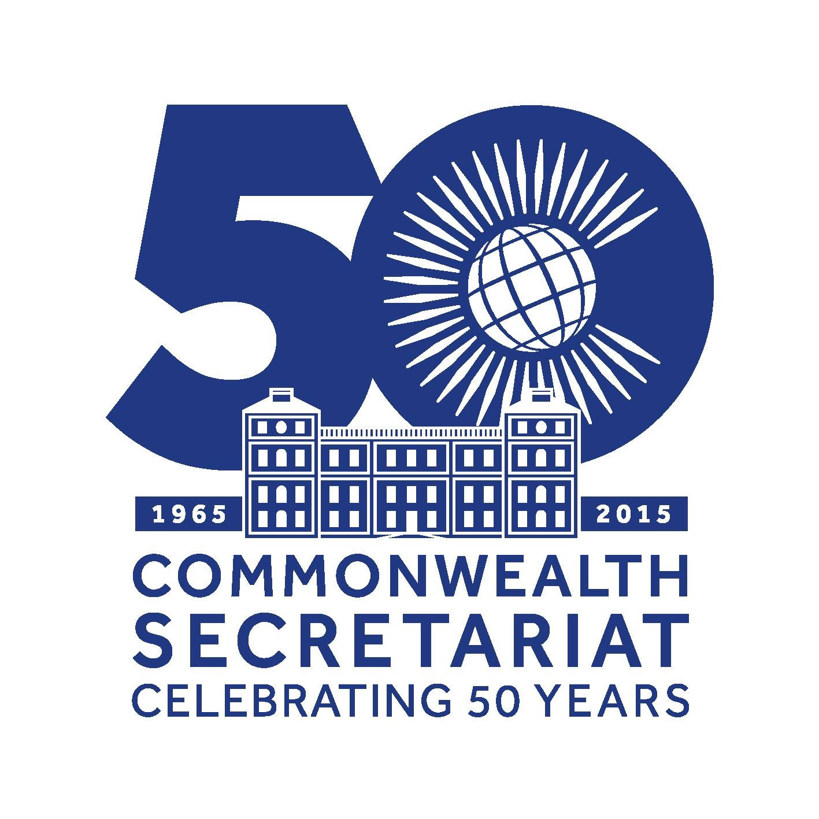

Slide 2
The Commonwealth story through staff eyes
(an unfinished story)

Slide 3
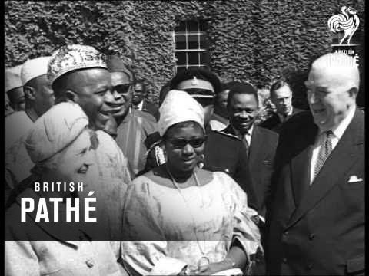
Where it all began ...
The 1965 summit which agreed to set up the Commonwealth Secretariat in London

Slide 4
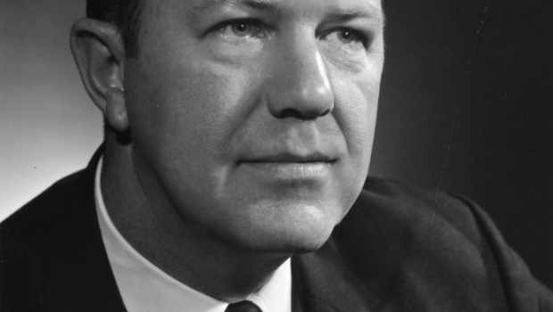
Arnold Smith (Canada)
First Commonwealth Secretary-General who fought to make the Secretariat an independent body

Slide 5
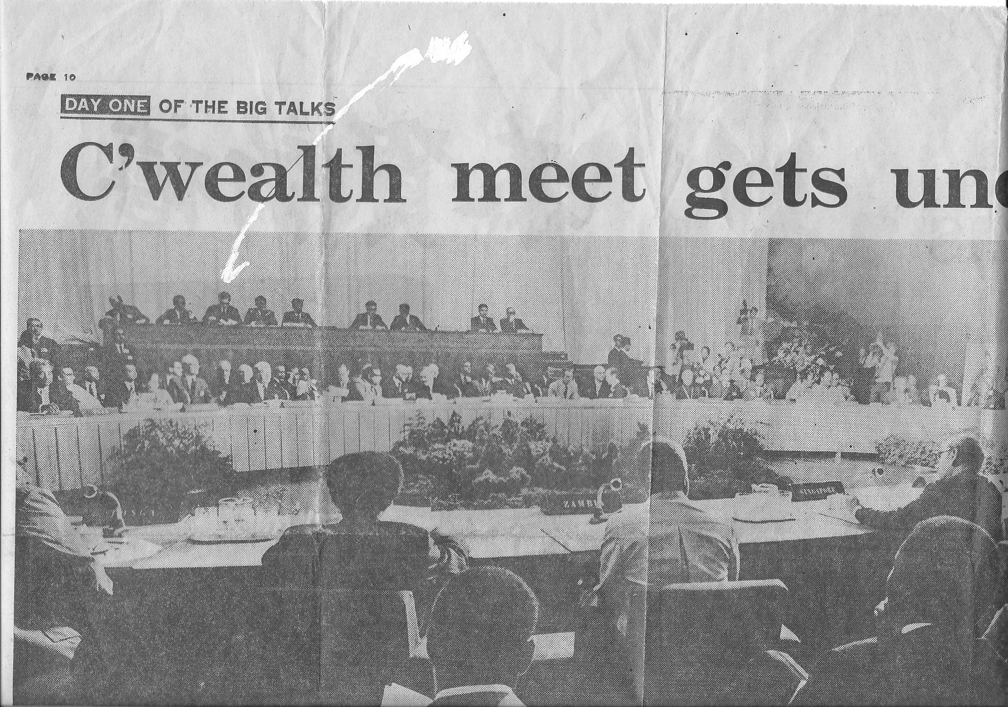
Singapore 1971 – the first CHOGM
Staffer David Sagar took minutes (white arrow points to him at high table at back) surrounded by Commonwealth leaders. Chief Anyaoku is on his right. The rest of the headline reads ‘underway’

Slide 6
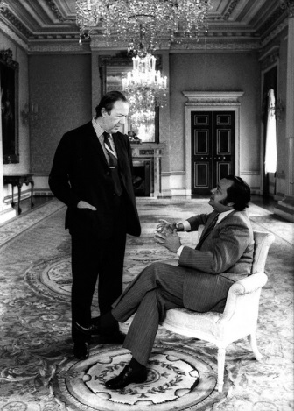
The handover…
Arnold Smith hands over the reins of Secretary –Generalship to Shridath Ramphal of Guyana, 1985

Slide 7
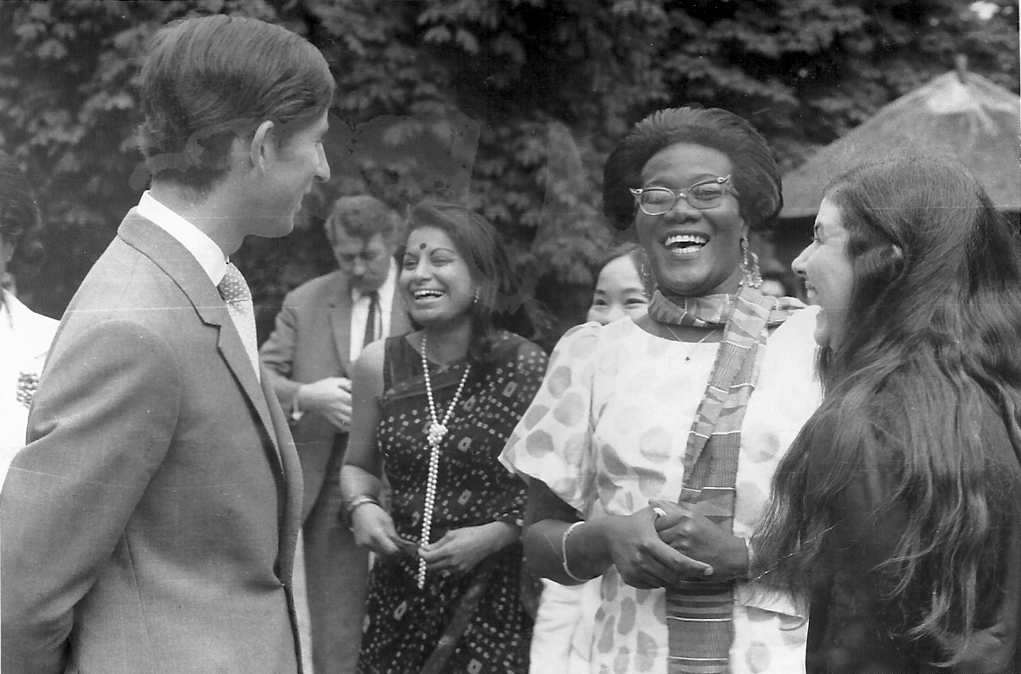
Royal visitor, 1970
Prince Charles shares a chuckle with Dharani Rethnam (centre) and
Annie Johnson

Slide 8
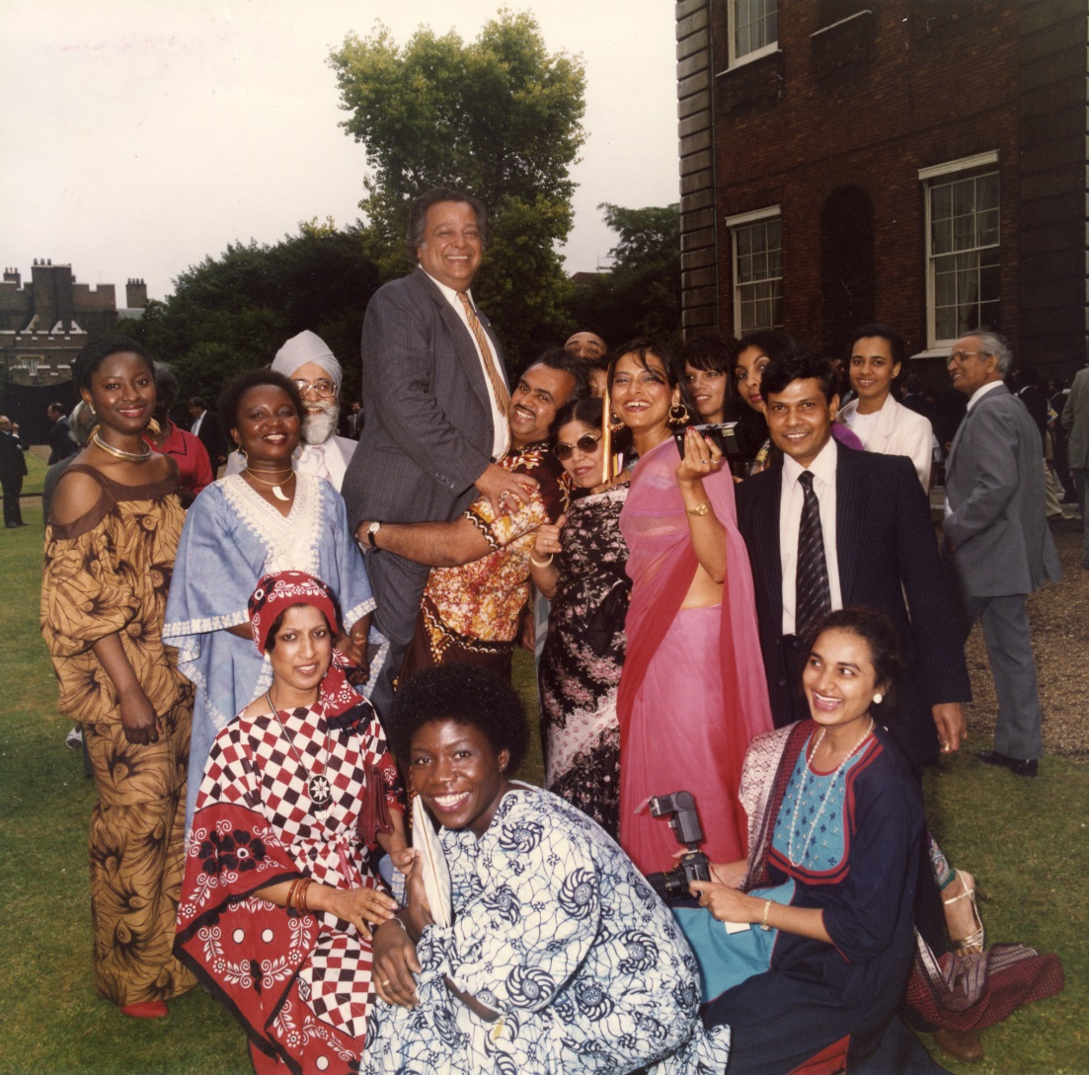
ComSec’s 10th anniversary, 1975
SG Shridath Ramphal hoisted aloft by staffers

Slide 9
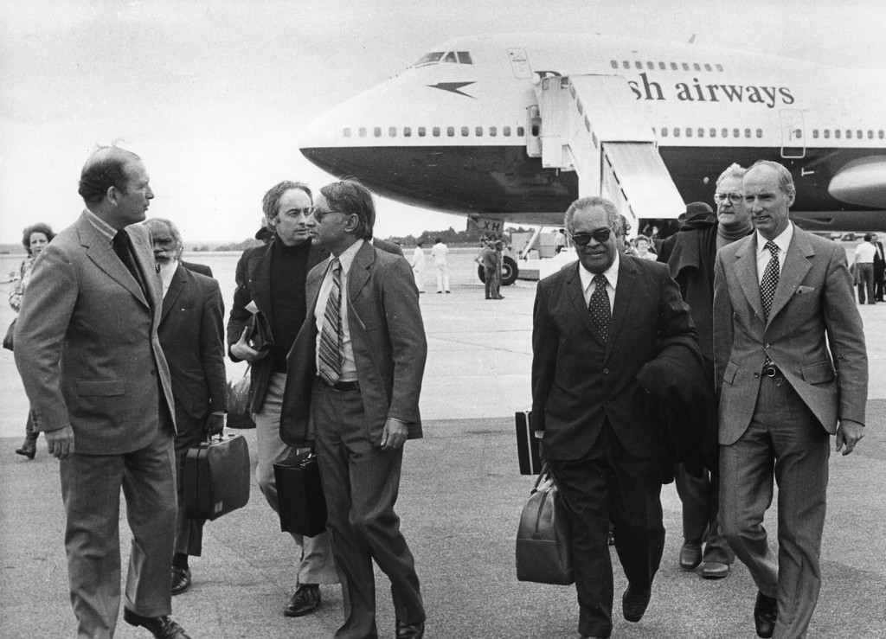
Zimbabwe’s historic elections 1980
Staffers Moni Malhoutra (centre) and Jeremy Pope (behind him) accompany observer s to the election which paved the way for independence

Slide 10
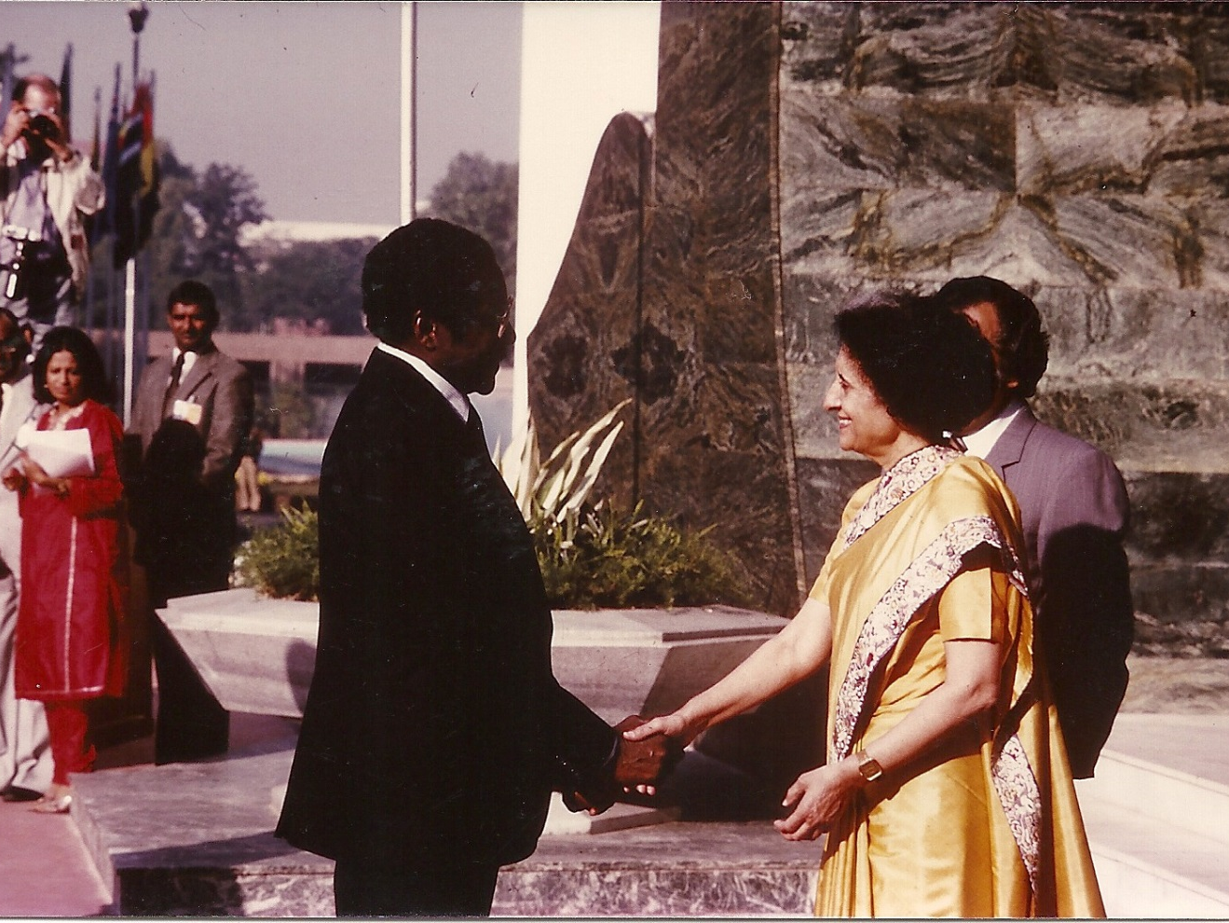
President Mugabe’s first CHOGM, New Delhi, 1983
Information’s Dharani Rethnam (in red) remembers Mrs Indira Gandhi smiled and said ‘Hello Robert’ in welcome

Slide 11
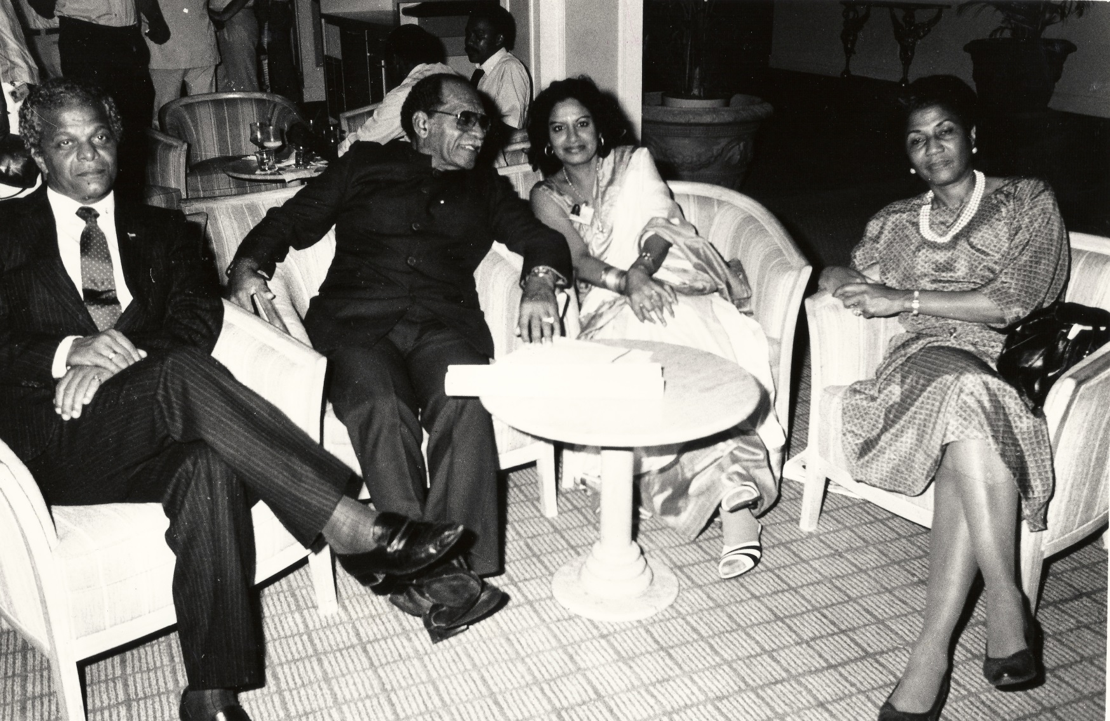
Hard at work …
3 a.m, at The Bahamas CHOGM 1985 and Information staff Dharani Rethnam (centre) and Patsy Robertson (right) are finally taking a break

Slide 12
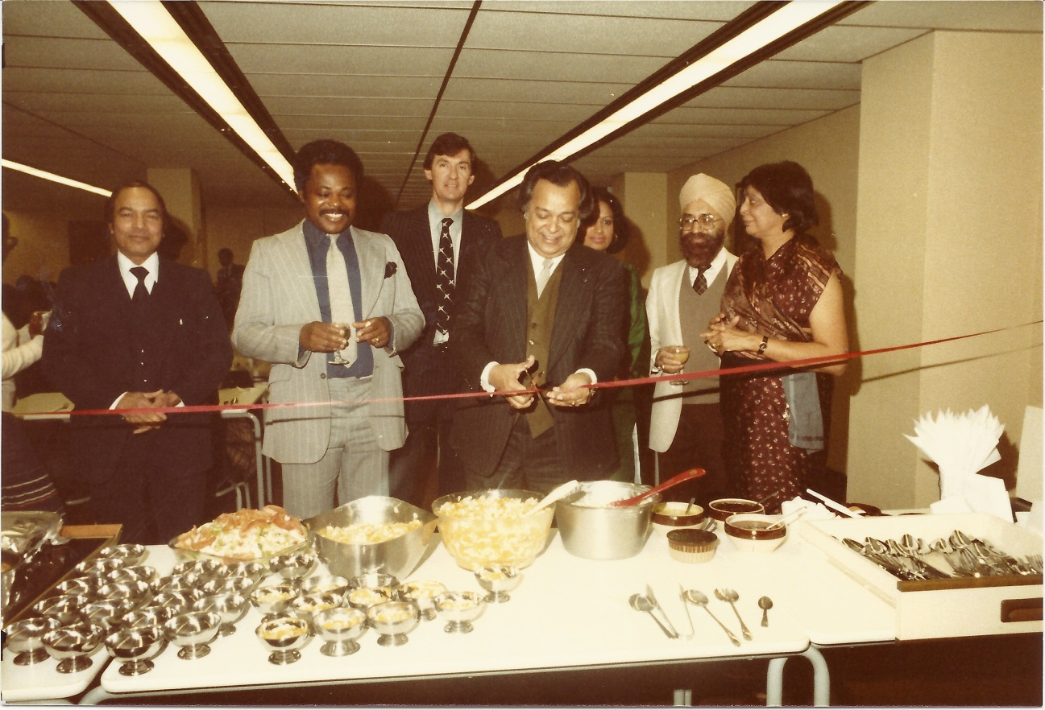
Grub’s up …day the canteen opened in 1984
Dharani Rethnam (half-hidden in green remembers the canteen in Quadrant House was a runaway success from the word go

Slide 13
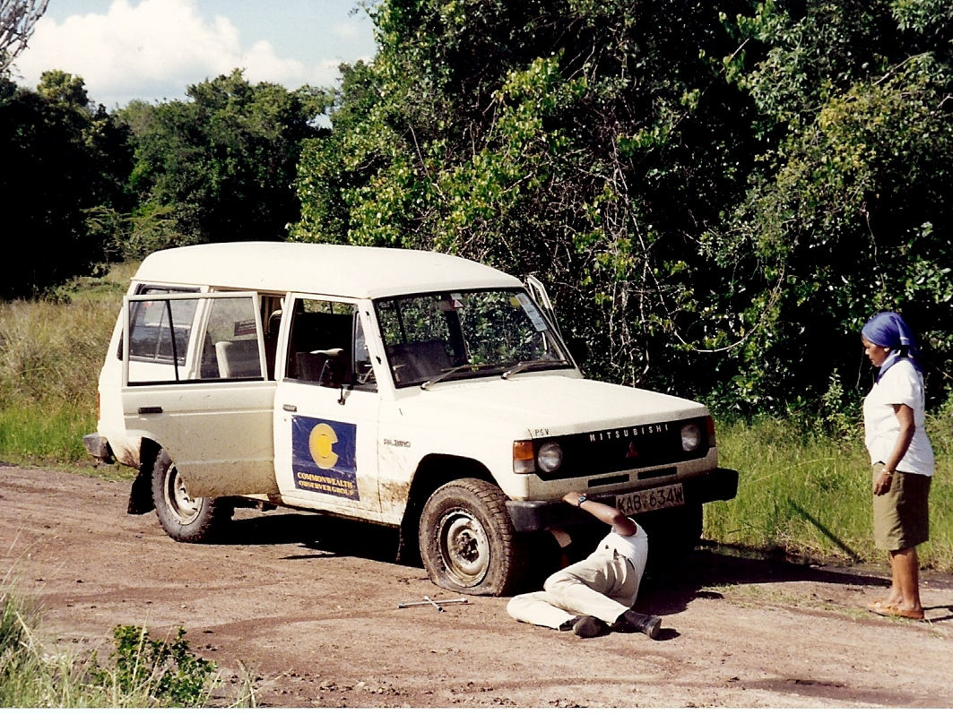
They sometimes serve who only wait …
Observer Josephine Obajo (PNG) with another tyre puncture. Kenya elections 1992. – pic: C. Bowman

Slide 14
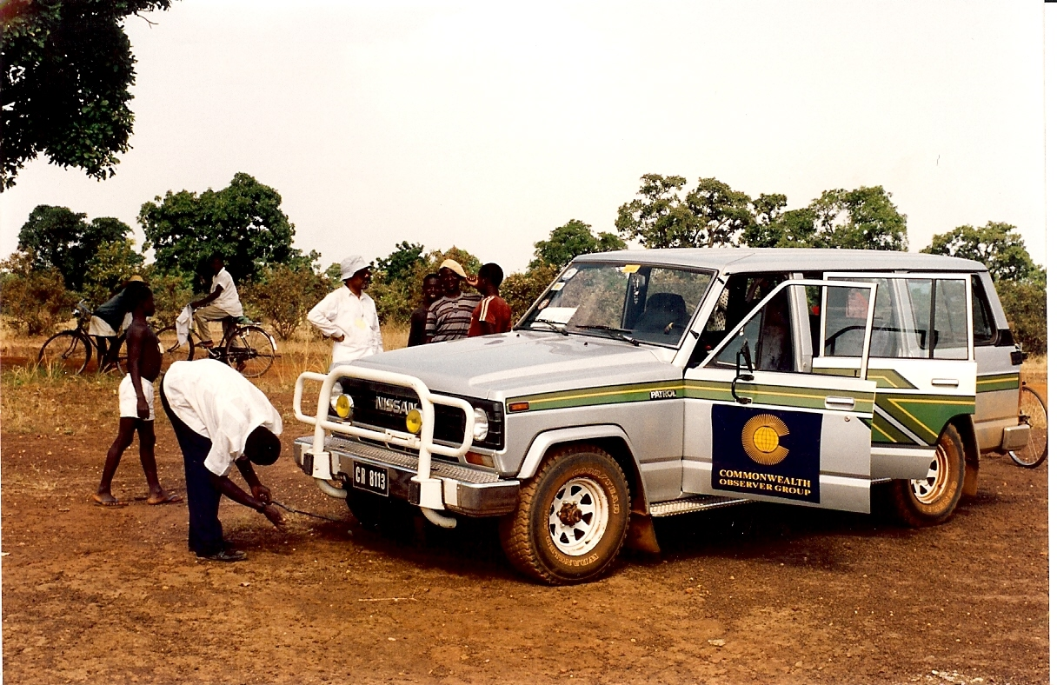
… and wait
Mauritius Observer (white hat and shirt) in enforced idleness at Ghana elections 1992. – Pic by C. Bowman

Slide 15
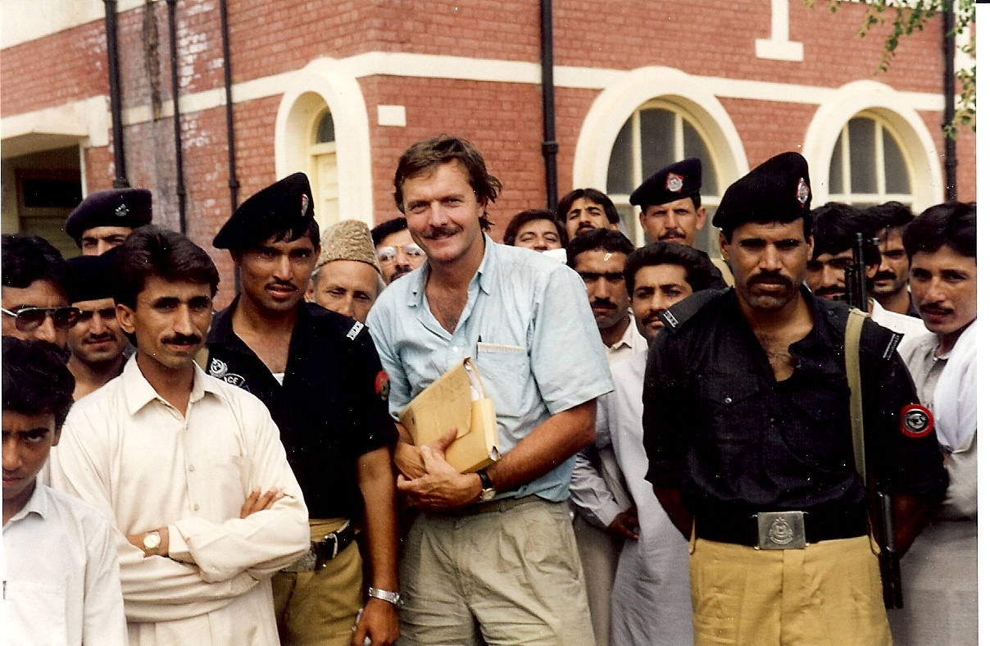
On the road with election observers 1993
Surrounded by policemen, Chris Bowman gets to work in the Pakistan elections

Slide 16
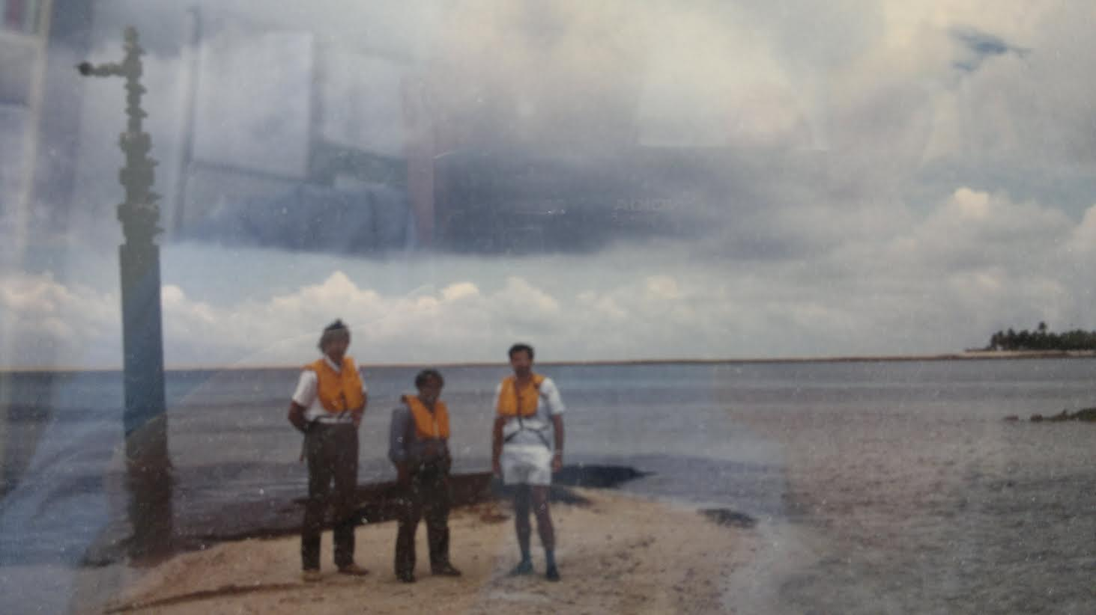
CFTC help with Tonga gas wells
CFTC’s Roger Nellist (right) in a blurred picture at gas wells n Tonga, 1983

Slide 17
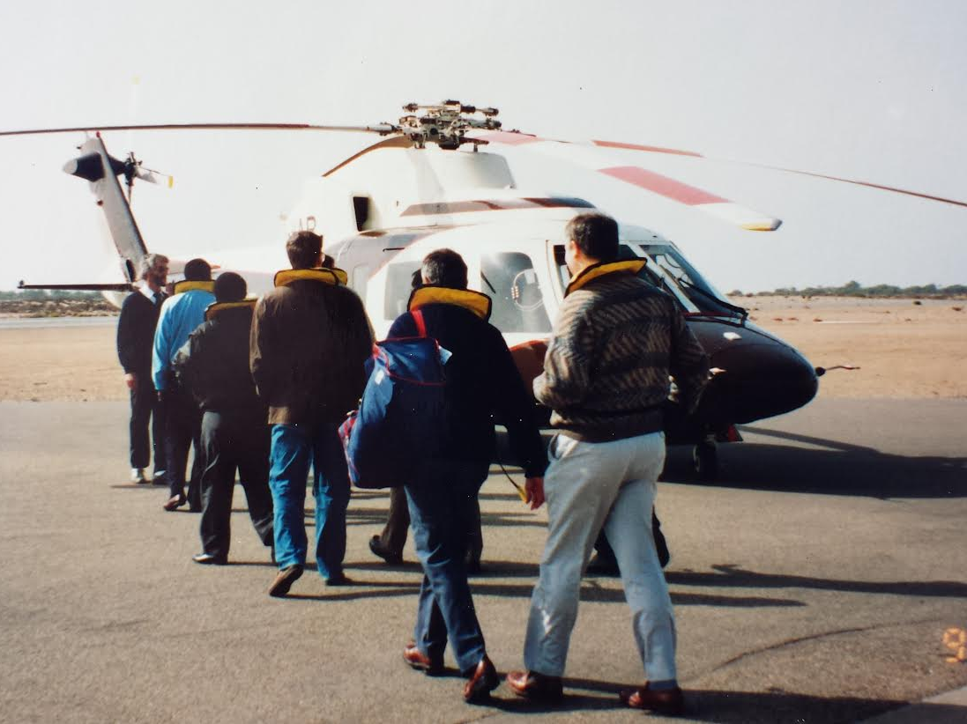
Travelling light offshore …
Inspection tour of offshore diamond mines by CFTC’s Roger Nellist (rear of line) and others, 1992

Slide 18
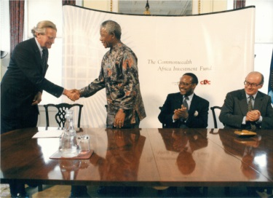
Bringing investment to the regions, 1996
President Mandala and British Deputy PM Michal Heseltine launch the Commonwealth Africa Private Investment Fund, applauded by Secretary-General Emeka Anyaoku

Slide 19
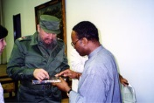
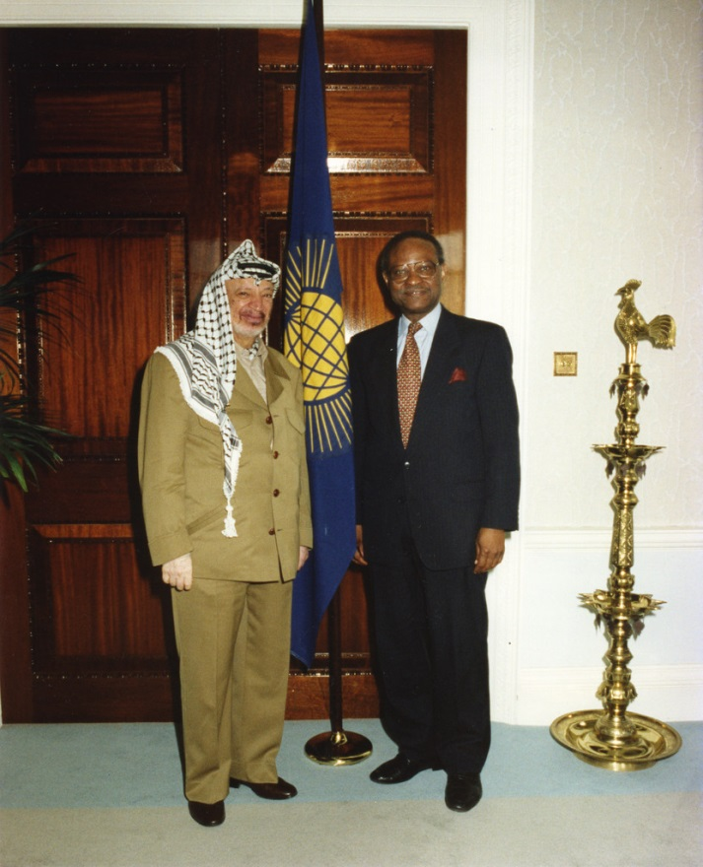
Visitors …
Cuba’s Fidel Castro invited Secretary-General Emeka Anyaoku to Cuba in 1995, and Yasser Arafat called in at Marlborough House in 1997

Slide 20
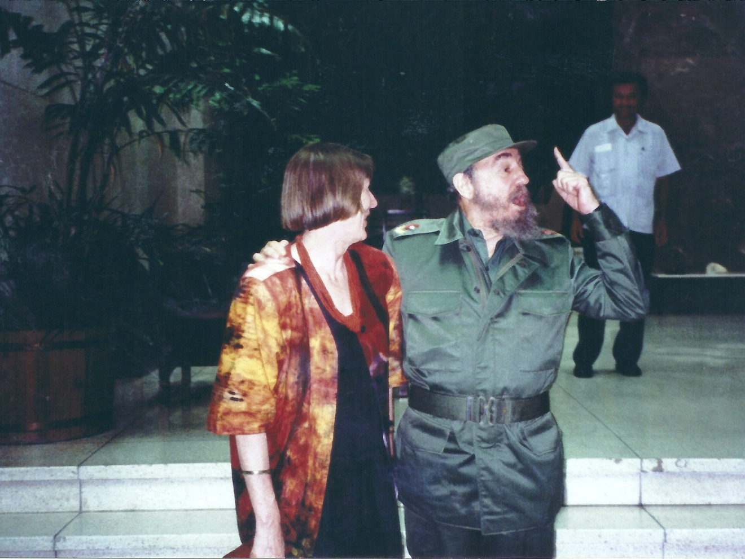
‘She too should have a photo with me ...’
Mary Mackie was taking photos of SG Anyaoku’s visit to Cuba, 1995, when she heard Fidel Castro say ‘She too should have a photo with me.’ And so she did

Slide 21
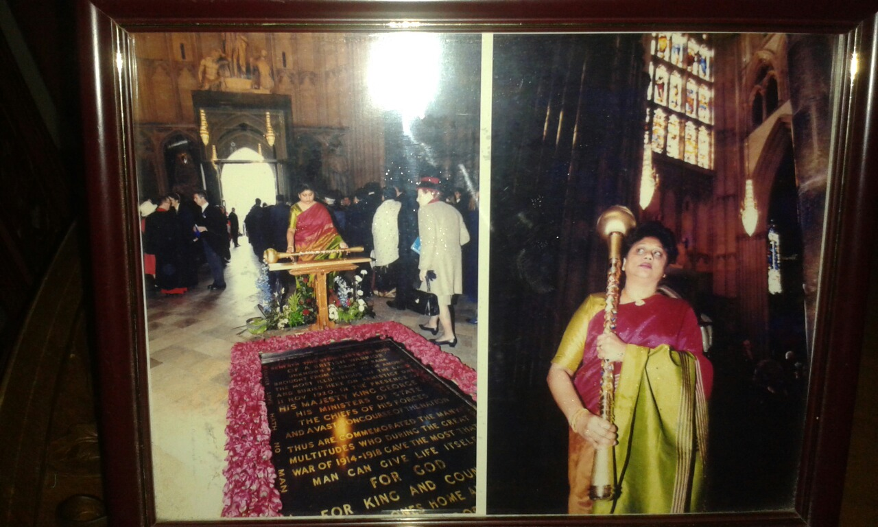
Proud mace bearer
Julie Balakrishnan, in 2000, first woman mace bearer on Commonwealth Day in Westminster Abbey. A heavy load, she said, but one borne proudly

Slide 22
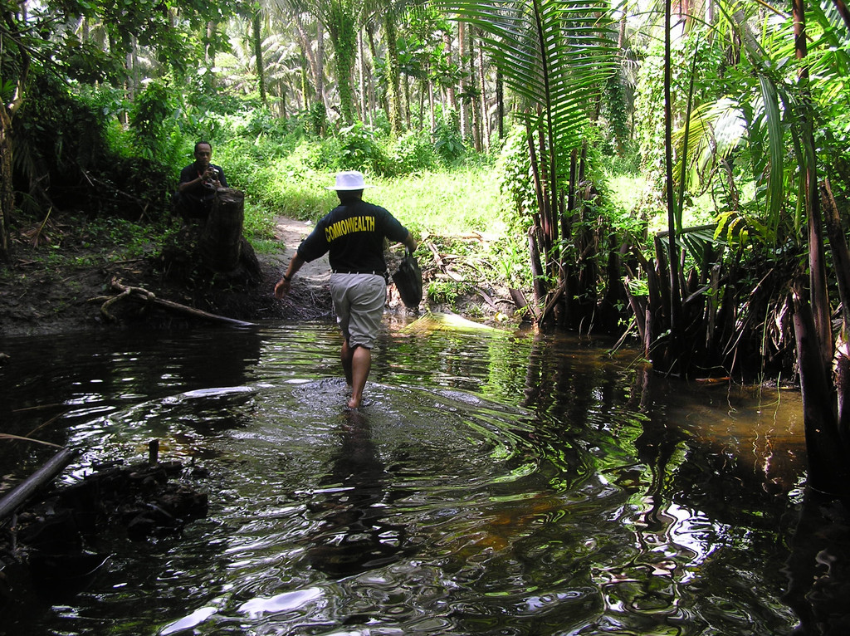
Walking on water …
Commonwealth Observer chairperson Sir Arnold Amet, at Solomon Islands elections 2006, wades through water in search of a polling station to observe. – Pic by Juliet Solomon

Slide 23
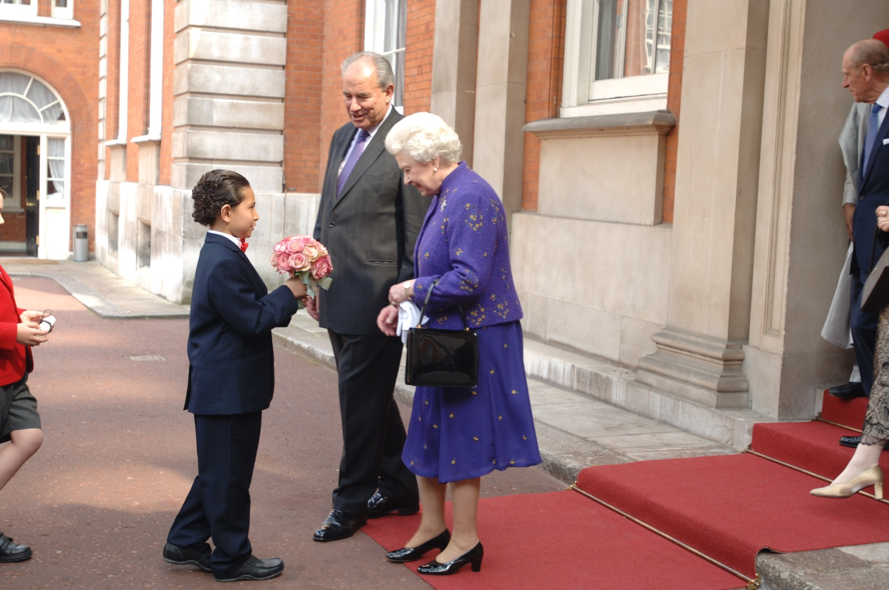
Proudest Day
For staffer Daniel Woolford whose step son, Russell, was chosen to present a posy to The Queen after her 80th birthday lunch given by the High Commissioners in Marlborough House, 2006

Slide 24
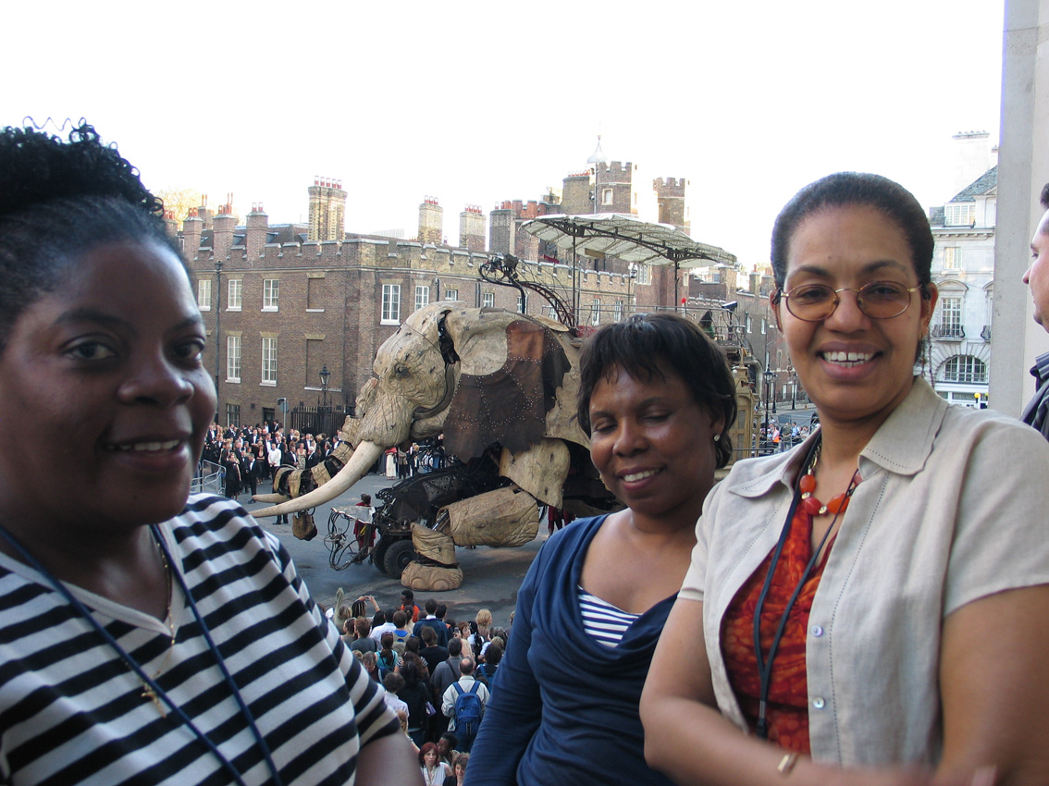
Day the elephant came by
Amazing what comes into view outside Quadrant House. Staffers Ivy Chikoti, Nike Famurewa and Amina Hassan goggle the Sultan’s Elephant street theatre in 2006. – Pic by D. Woolford

