Slide 1
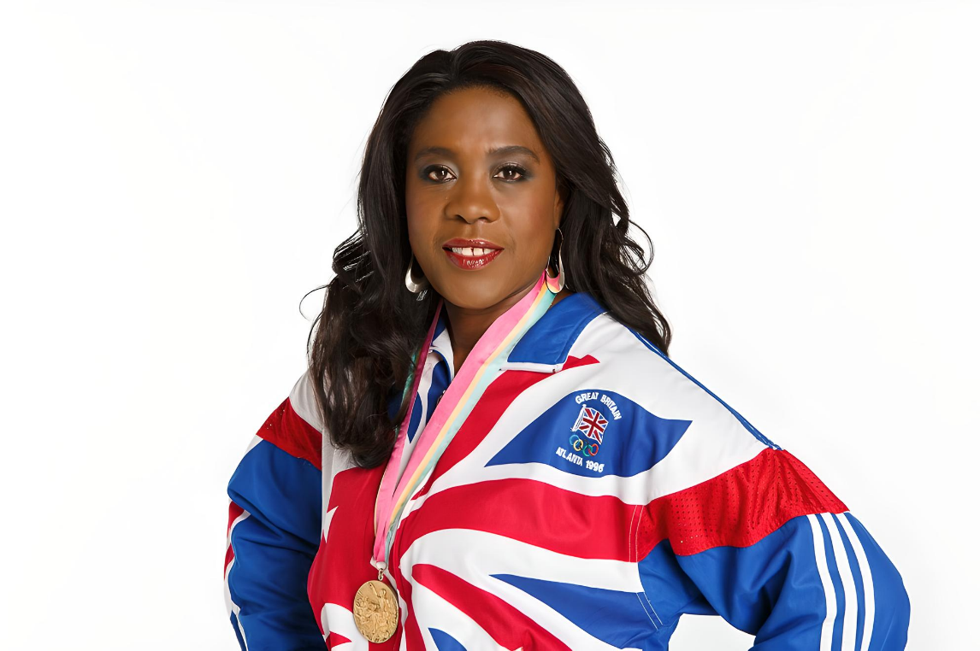
4th Patsy Robertson Memorial Lecture
Sport, Development and The Commonwealth
Tessa Sanderson CBE
Monday, 14 October 2024

Slide 2
Tessa’s
Commonwealth Snapshots

Slide 3
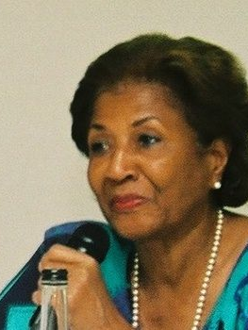
Patsy Robertson
“I never met Patsy but, happy to say, I share a connection with her. We were both born in St Elizabeth parish in Jamaica, though some years apart. Like Patsy and so many of our compatriots, my family took the path out of our beautiful island home and chose a new life in the UK”.

Slide 4
Coming to the United Kingdom
“Like Patsy, I found a different world in the UK - one of snow and fog, but also of racism and hostility, even if there was also kindness and generosity.
My parents settled in Wolverhampton .. and it was one of the city’s MPs, Enoch Powell, who in 1968 greatly increased racial tensions with his unforgivable ‘rivers of blood’ speech in Birmingham. I was barely a teenager, but I felt the massive hurt as we were singled out as people of colour.
Racism was rife and it was a difficult time for anyone with a black skin…But my parents were always mindful of these happenings and taught us well about resilience and strength. It was something I never forgot.”

Slide 5
Tessa’s Early Years
“My childhood wasn’t only about challenge – it was also about my fantastic PE teacher, Barbara Richards, opening the door to opportunity. It was she who spotted and nurtured the sporting talent within me.
It led me to compete in six Olympic Games between 1976 – 1996, winning the Gold medal and Olympic record in 1984 at Los Angeles, three Gold medals at the Commonwealth Games, and the World Gold and European silver medals too.”

Slide 6
Tessa with Sonia Lannaman
“At the 1978 Edmonton Commonwealth Games in Canada (where I won Gold), one of my heroes and a great friend, Sonia Lannaman, won two Gold medals and a Silver.
Sonia was a Black sprinter who I had met when I first started my athletics career at Wolverhampton and Bilston AC. I remember seeing her run and so much wanted to be like her in the sporting arena.
We shared many great sporting moments together and are still great friends to this day.”

Slide 7
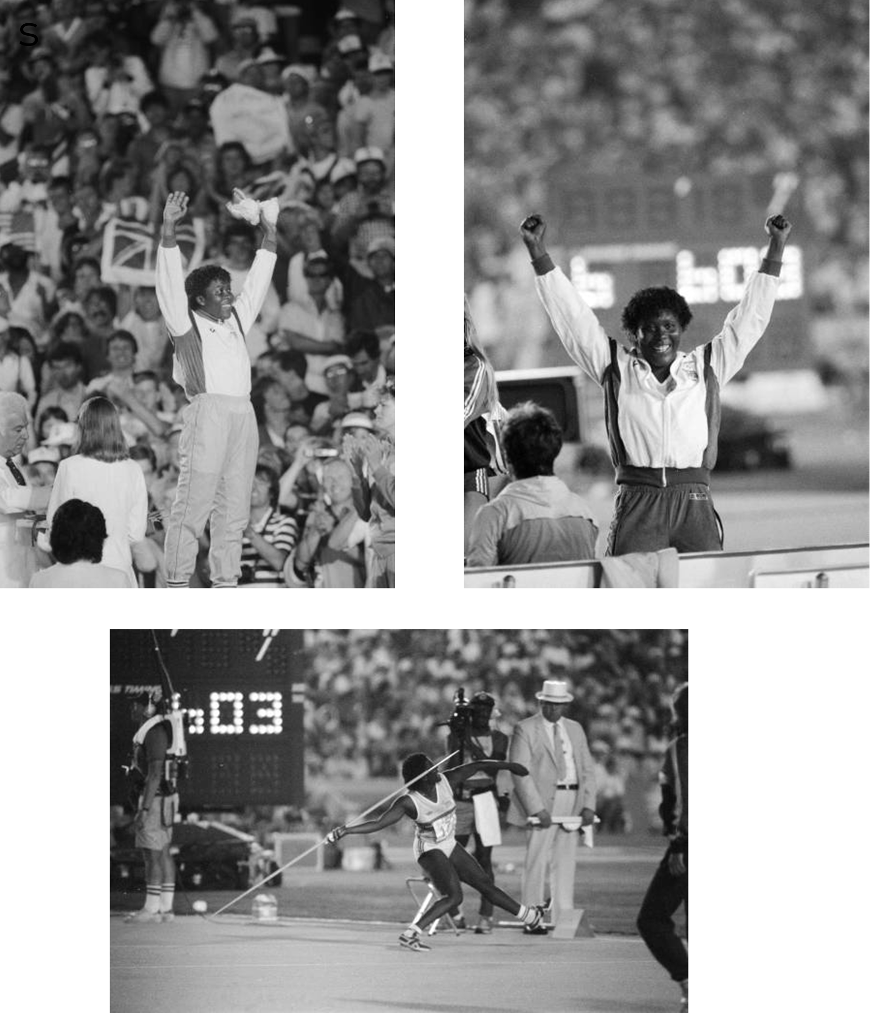
Tessa winning Olympic Gold
“I achieved my greatest triumph in 1984, winning an Olympic Gold medal and setting a new Olympic record.
It is still historic – no male or female has ever won an Olympic throwing gold medal for Great Britain.
As the late Ron Pickering said during his TV commentary that day: “You know it, she knows it .. the Gold medal is hers – and that’s history!”

Slide 8
Tessa with her husband (and fellow Olympian), Densign White, at a gala event
“I am pleased to give back what I can and help kids discover their talents.
In 1993, I was chosen as the first woman to become Vice Chair of Sports England, the largest grassroots charity for kids in sport in England.
I started the first real sporting academy with selected sports coaches – the Newham Sports Academy – to help identify youngsters in the local community and to nurture their sporting talent. Over the years, we have had many successes with this programme, including at the 2024 Olympics in Paris.”

Slide 9
Queen’s Baton Ceremony, Birmingham 2022 Commonwealth Games
“I am a supporter of the Commonwealth, a child of the Commonwealth, and a believer with all other Commonwealth Games participants, past and present. We believe in the unique value of the Commonwealth Games and the great pathway it has prepared for many to achieve success in sport.”
Prince William joins Tessa Sanderson and Ed Clancy at the Queen’s Baton Ceremony, 10 February 2022

Slide 10
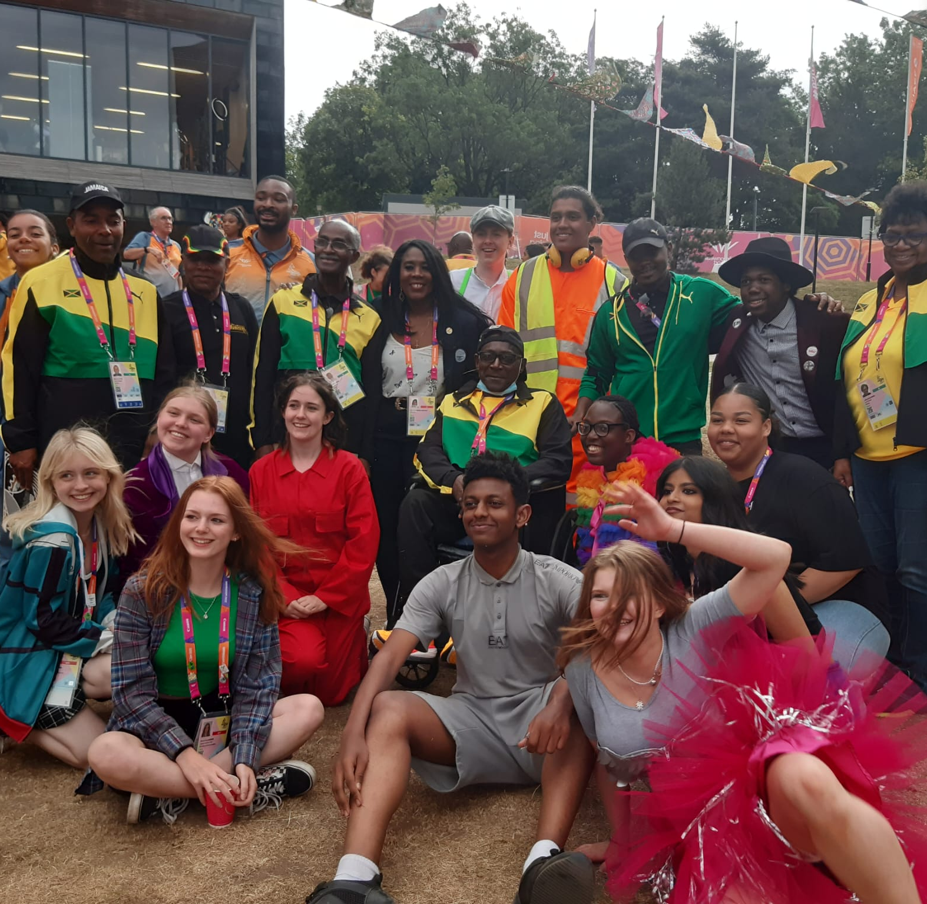
Tessa at the 2022 Commonwealth Games
“The Birmingham Games, in 2022, saw four world records broken.
But it also saw a surge in visitors to the city; nearly one million young people engaged with the Games either through volunteering or in associated programmes; and 22,380 full-time equivalent years in employment created in delivering the event.
The city and its communities also saw a 27% increase in foreign direct investment projects. Overall, the Games generated an additional £1.2 billion in goods and services, almost half in the West Midlands itself.”

Slide 11
Tessa: promoting the Commonwealth Games
“The Commonwealth Games have been a ground breaker in promoting athletic excellence, inclusivity, fraternity and community.
Among other things, the Games have advanced women’s sports and encouraged participants from small states.
The Games have undergone many changes and challenges over the years. They have survived, adapted and re-made themselves to be fit for the new age. Resetting the Games for the long term is now the task and I wish the Commonwealth Games Federation all the very best, and every success, in that important mission.”

Slide 12
“Patsy, We thank you for your exceptional service and for inspiring us all.”

