Slide 1
A reflection on the life of Patsy Robertson
28th August 1933 - 18th August 2020

Slide 2
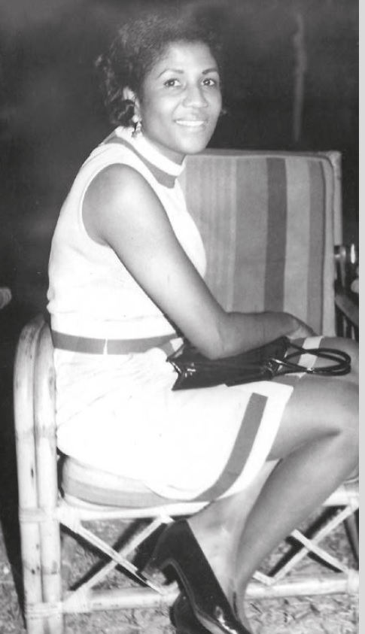
Notes:
x

Slide 3
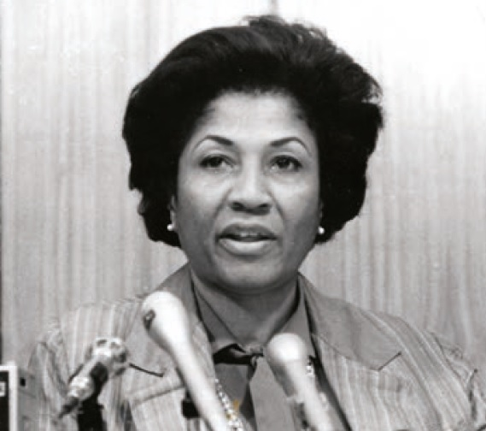
Notes:
x

Slide 4
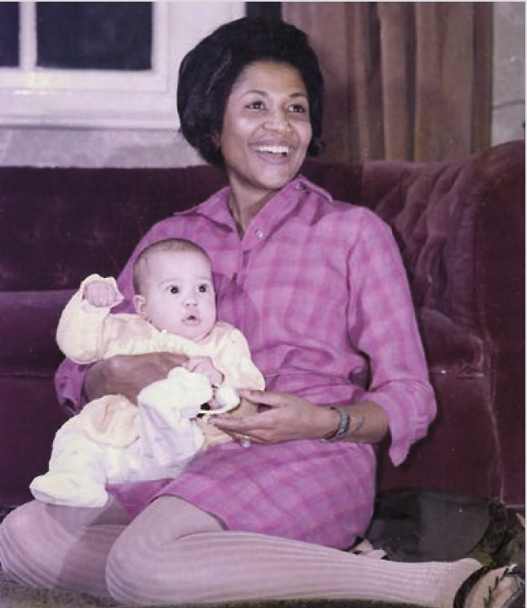
Notes:
x

Slide 5
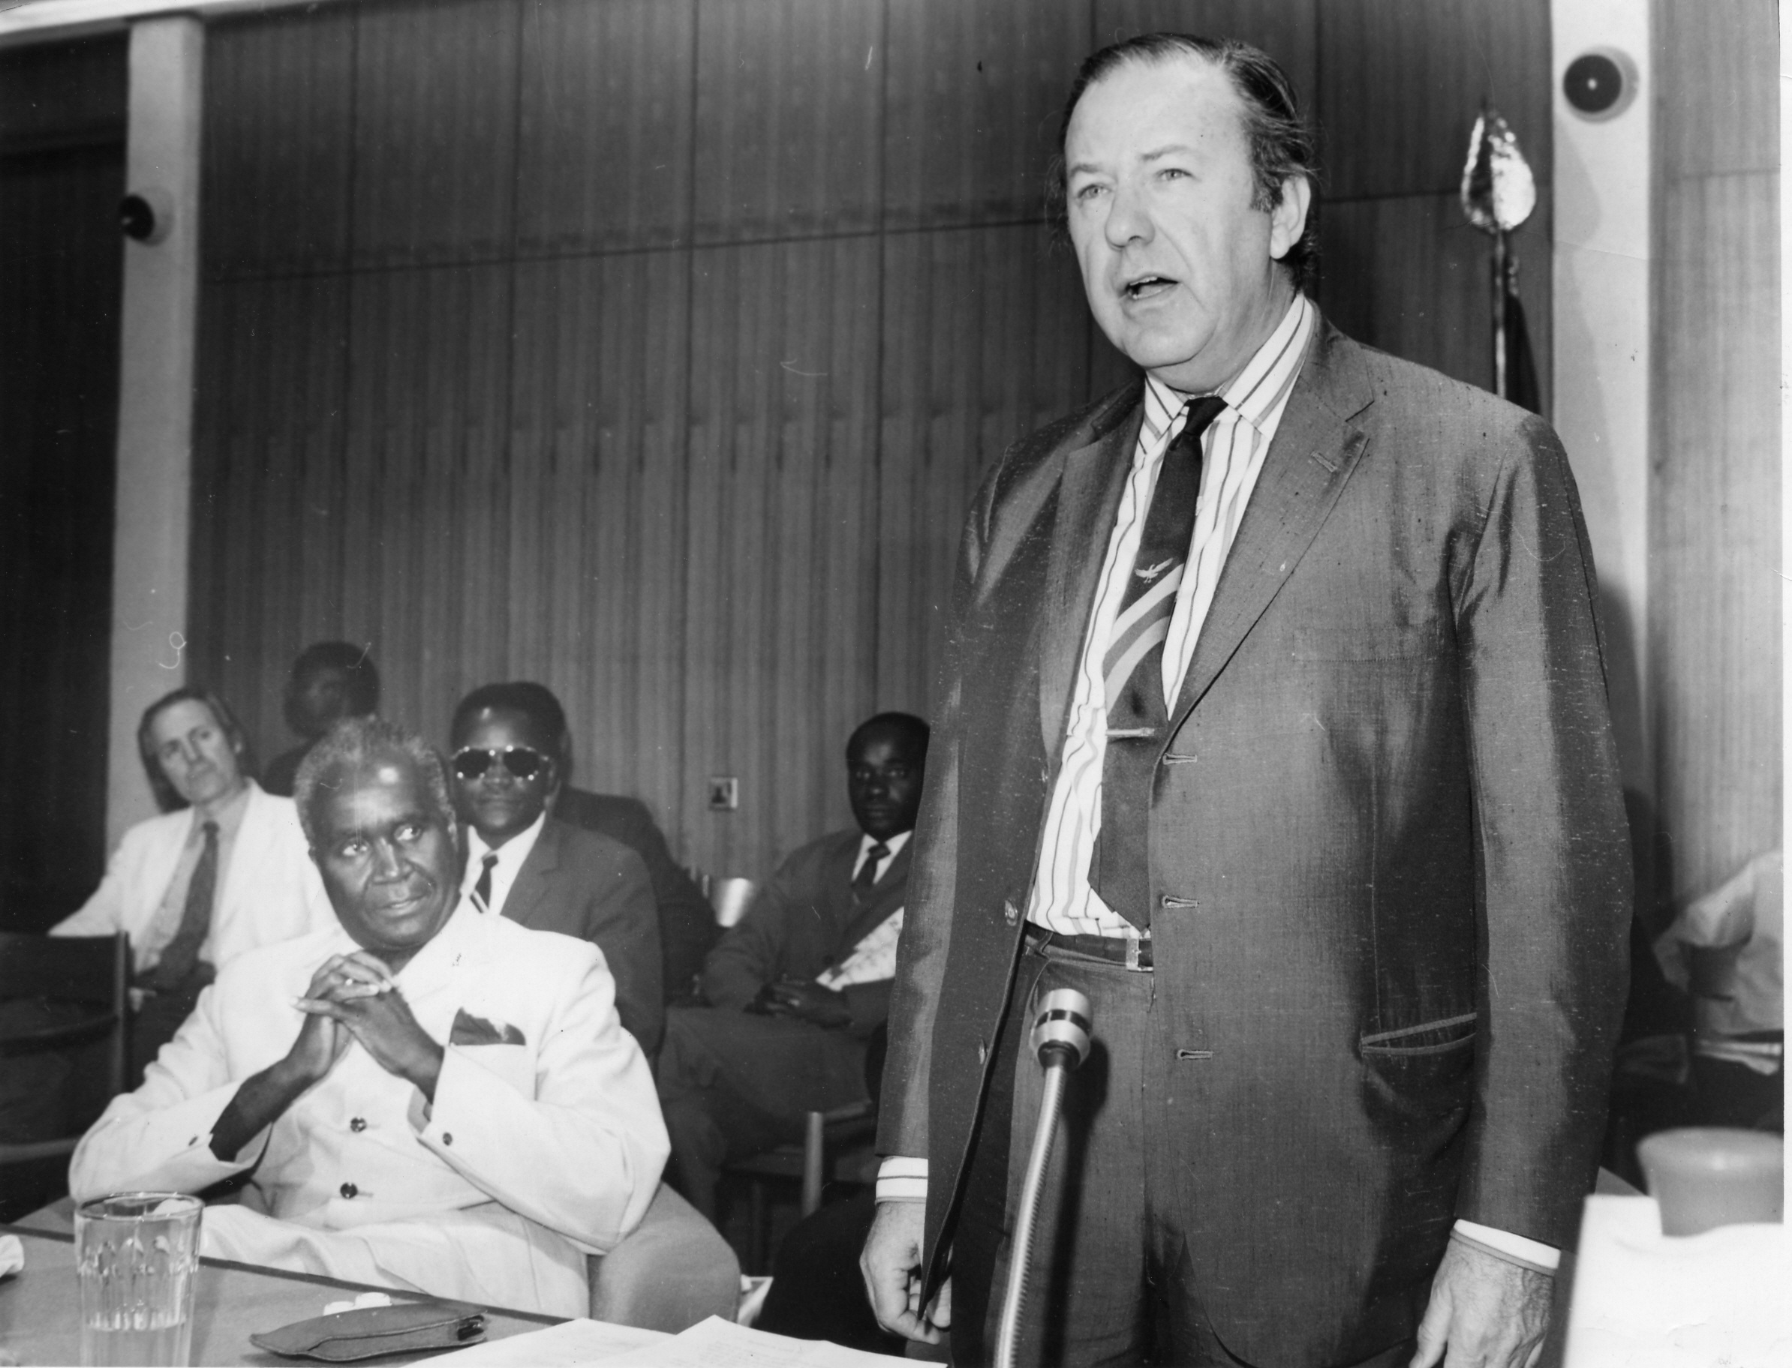
Others brought different qualities to the early mixture at the Secretariat. Patsy Robertson, warm and cheerful and practiced in jollying along the media in London ever since her days as press attache for the West Indies Federation; yet, when it was necessary, a delightful deflater who could puncture stupidity or self-importance on the part of any pressman, Minister or colleague.
Former Secretary-General
Arnold Smith

Slide 6
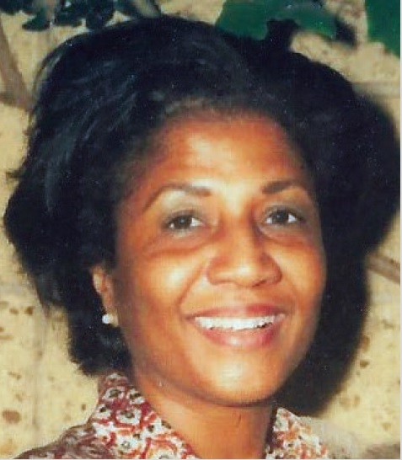
Notes:
X

Slide 7
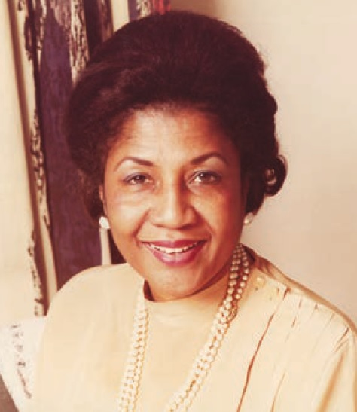
Notes:
x

Slide 8
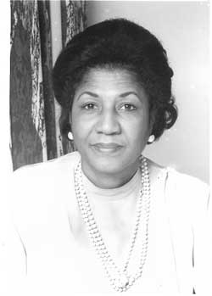

Slide 9
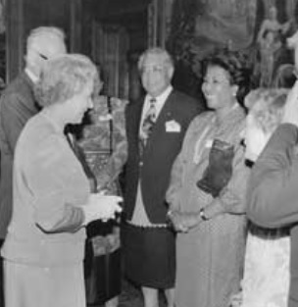

Slide 10
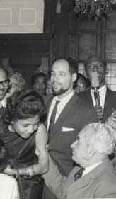

Slide 11
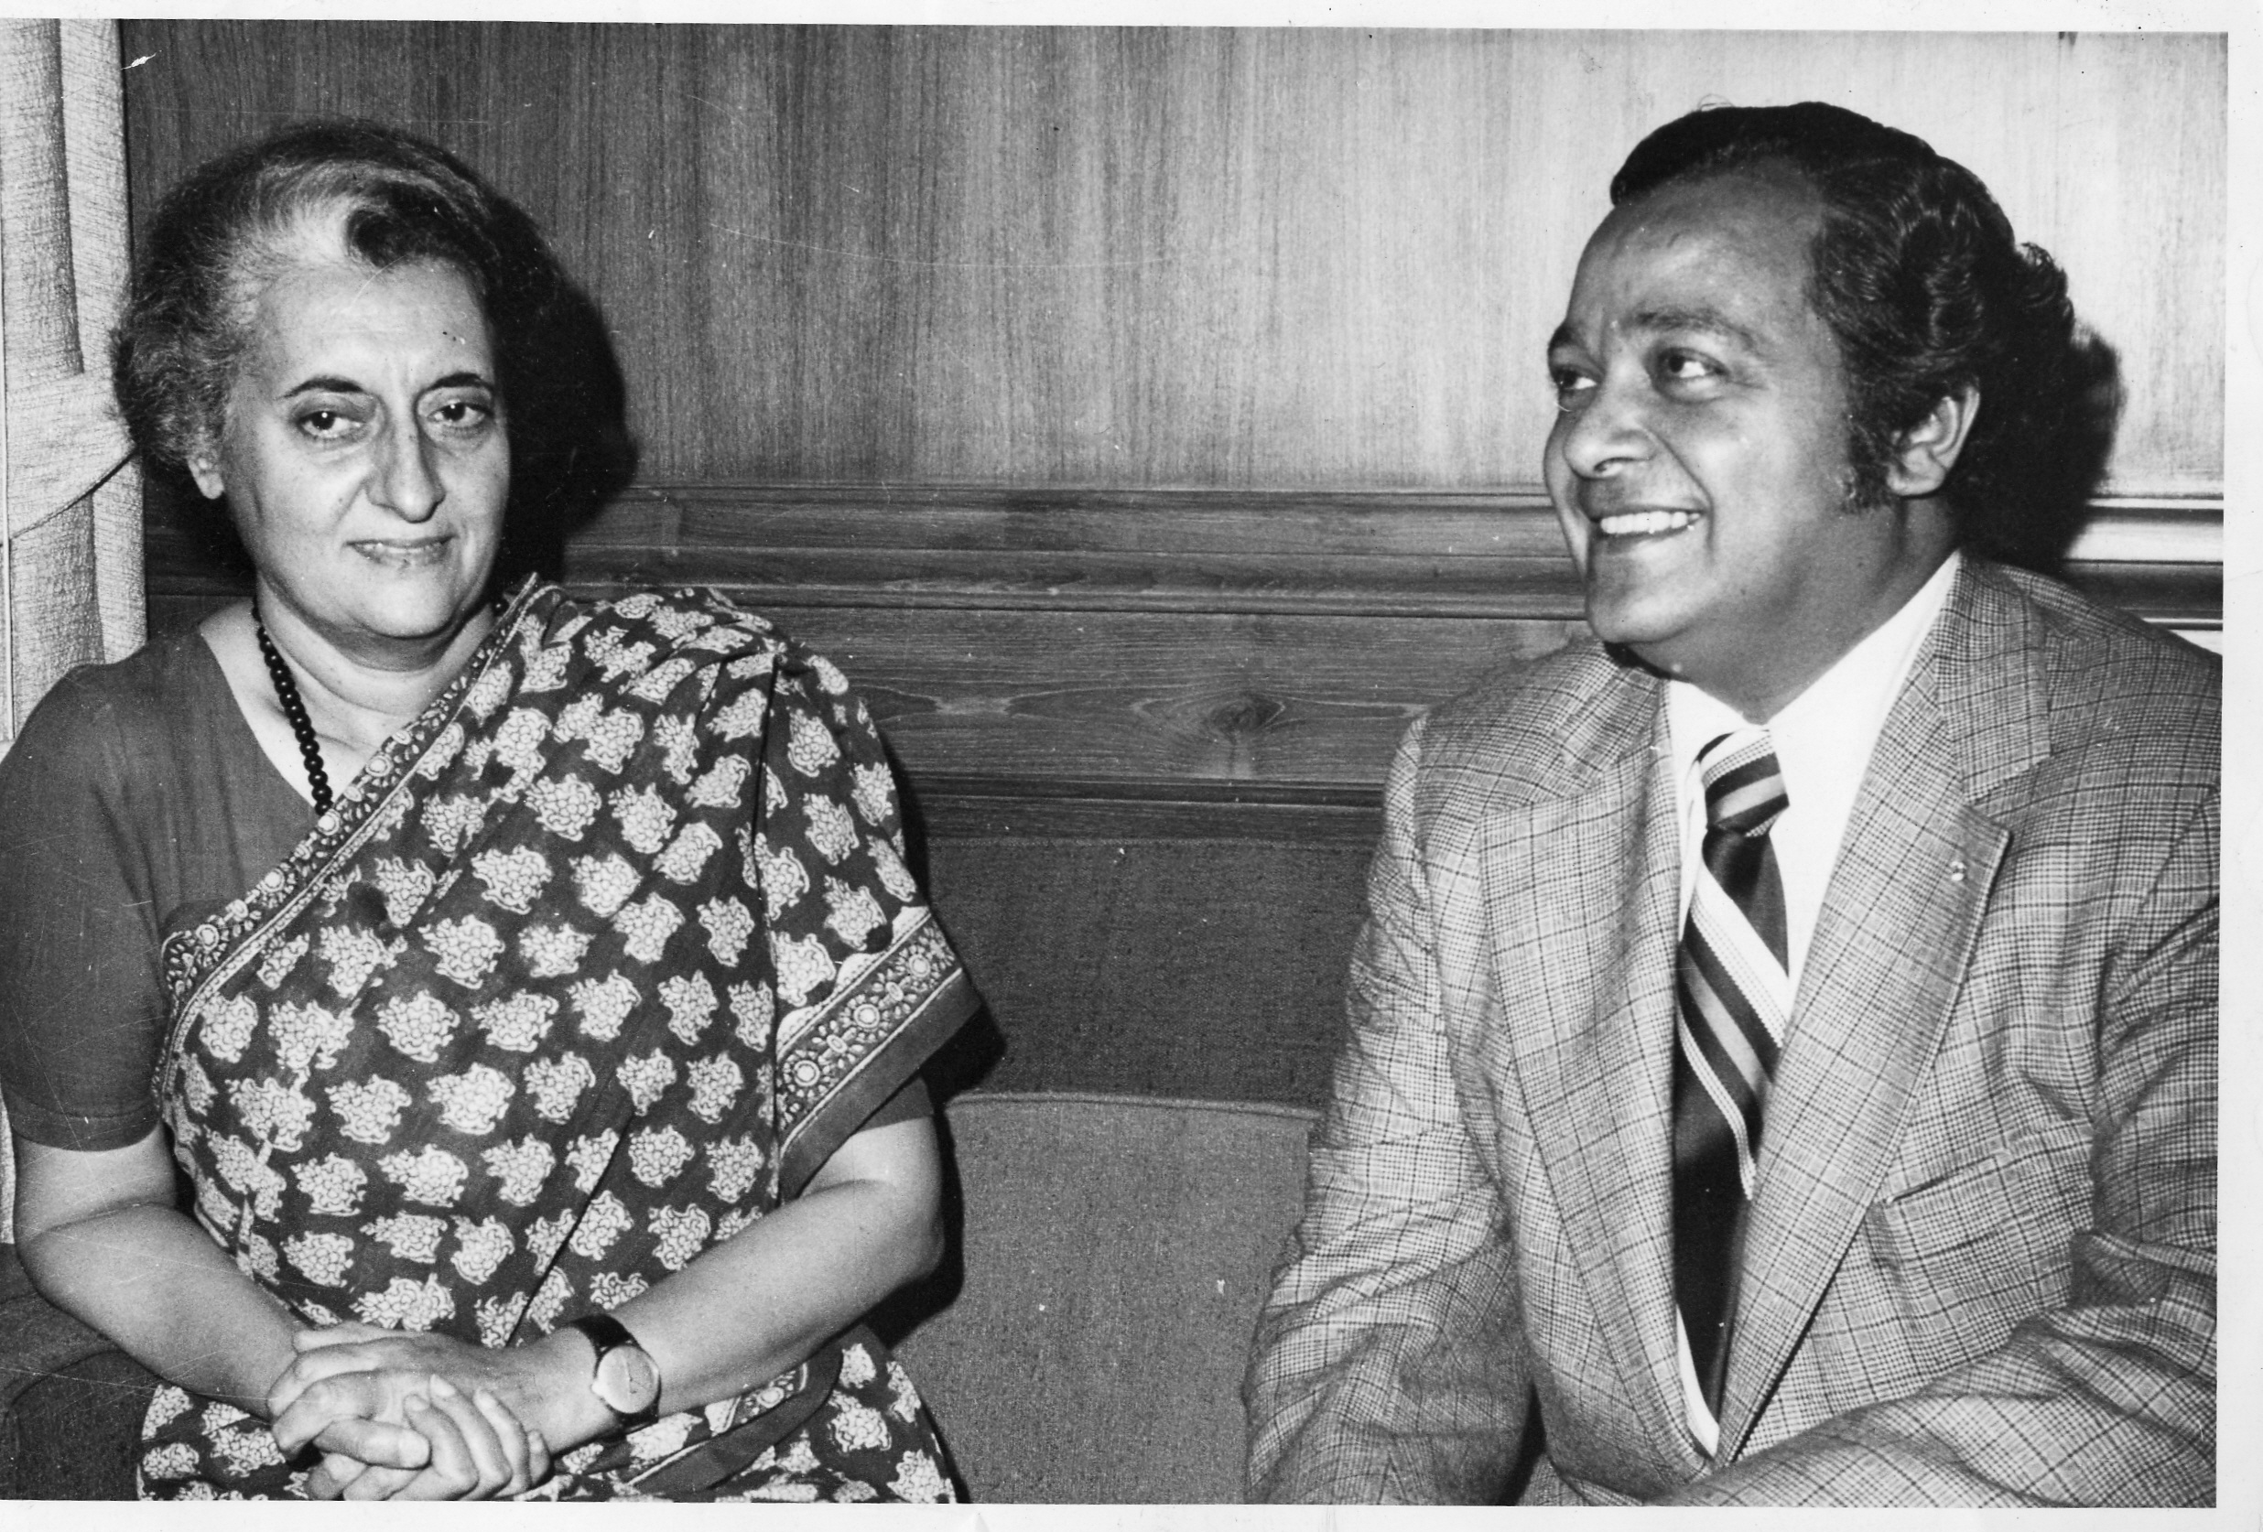
The Commonwealth sky clouded over as Patsy Robertson left us. She had given her life to the Commonwealth – from the Secretariat’s beginning to her own end. I pay tribute to the service she gave over all those years. I acknowledge my personal debt to her for all our work together world-wide, and pay homage to the memory of her service.
Former Secretary-General
Shridath Rampahl
Former Secretary-General
Shridath Ramphal

Slide 12
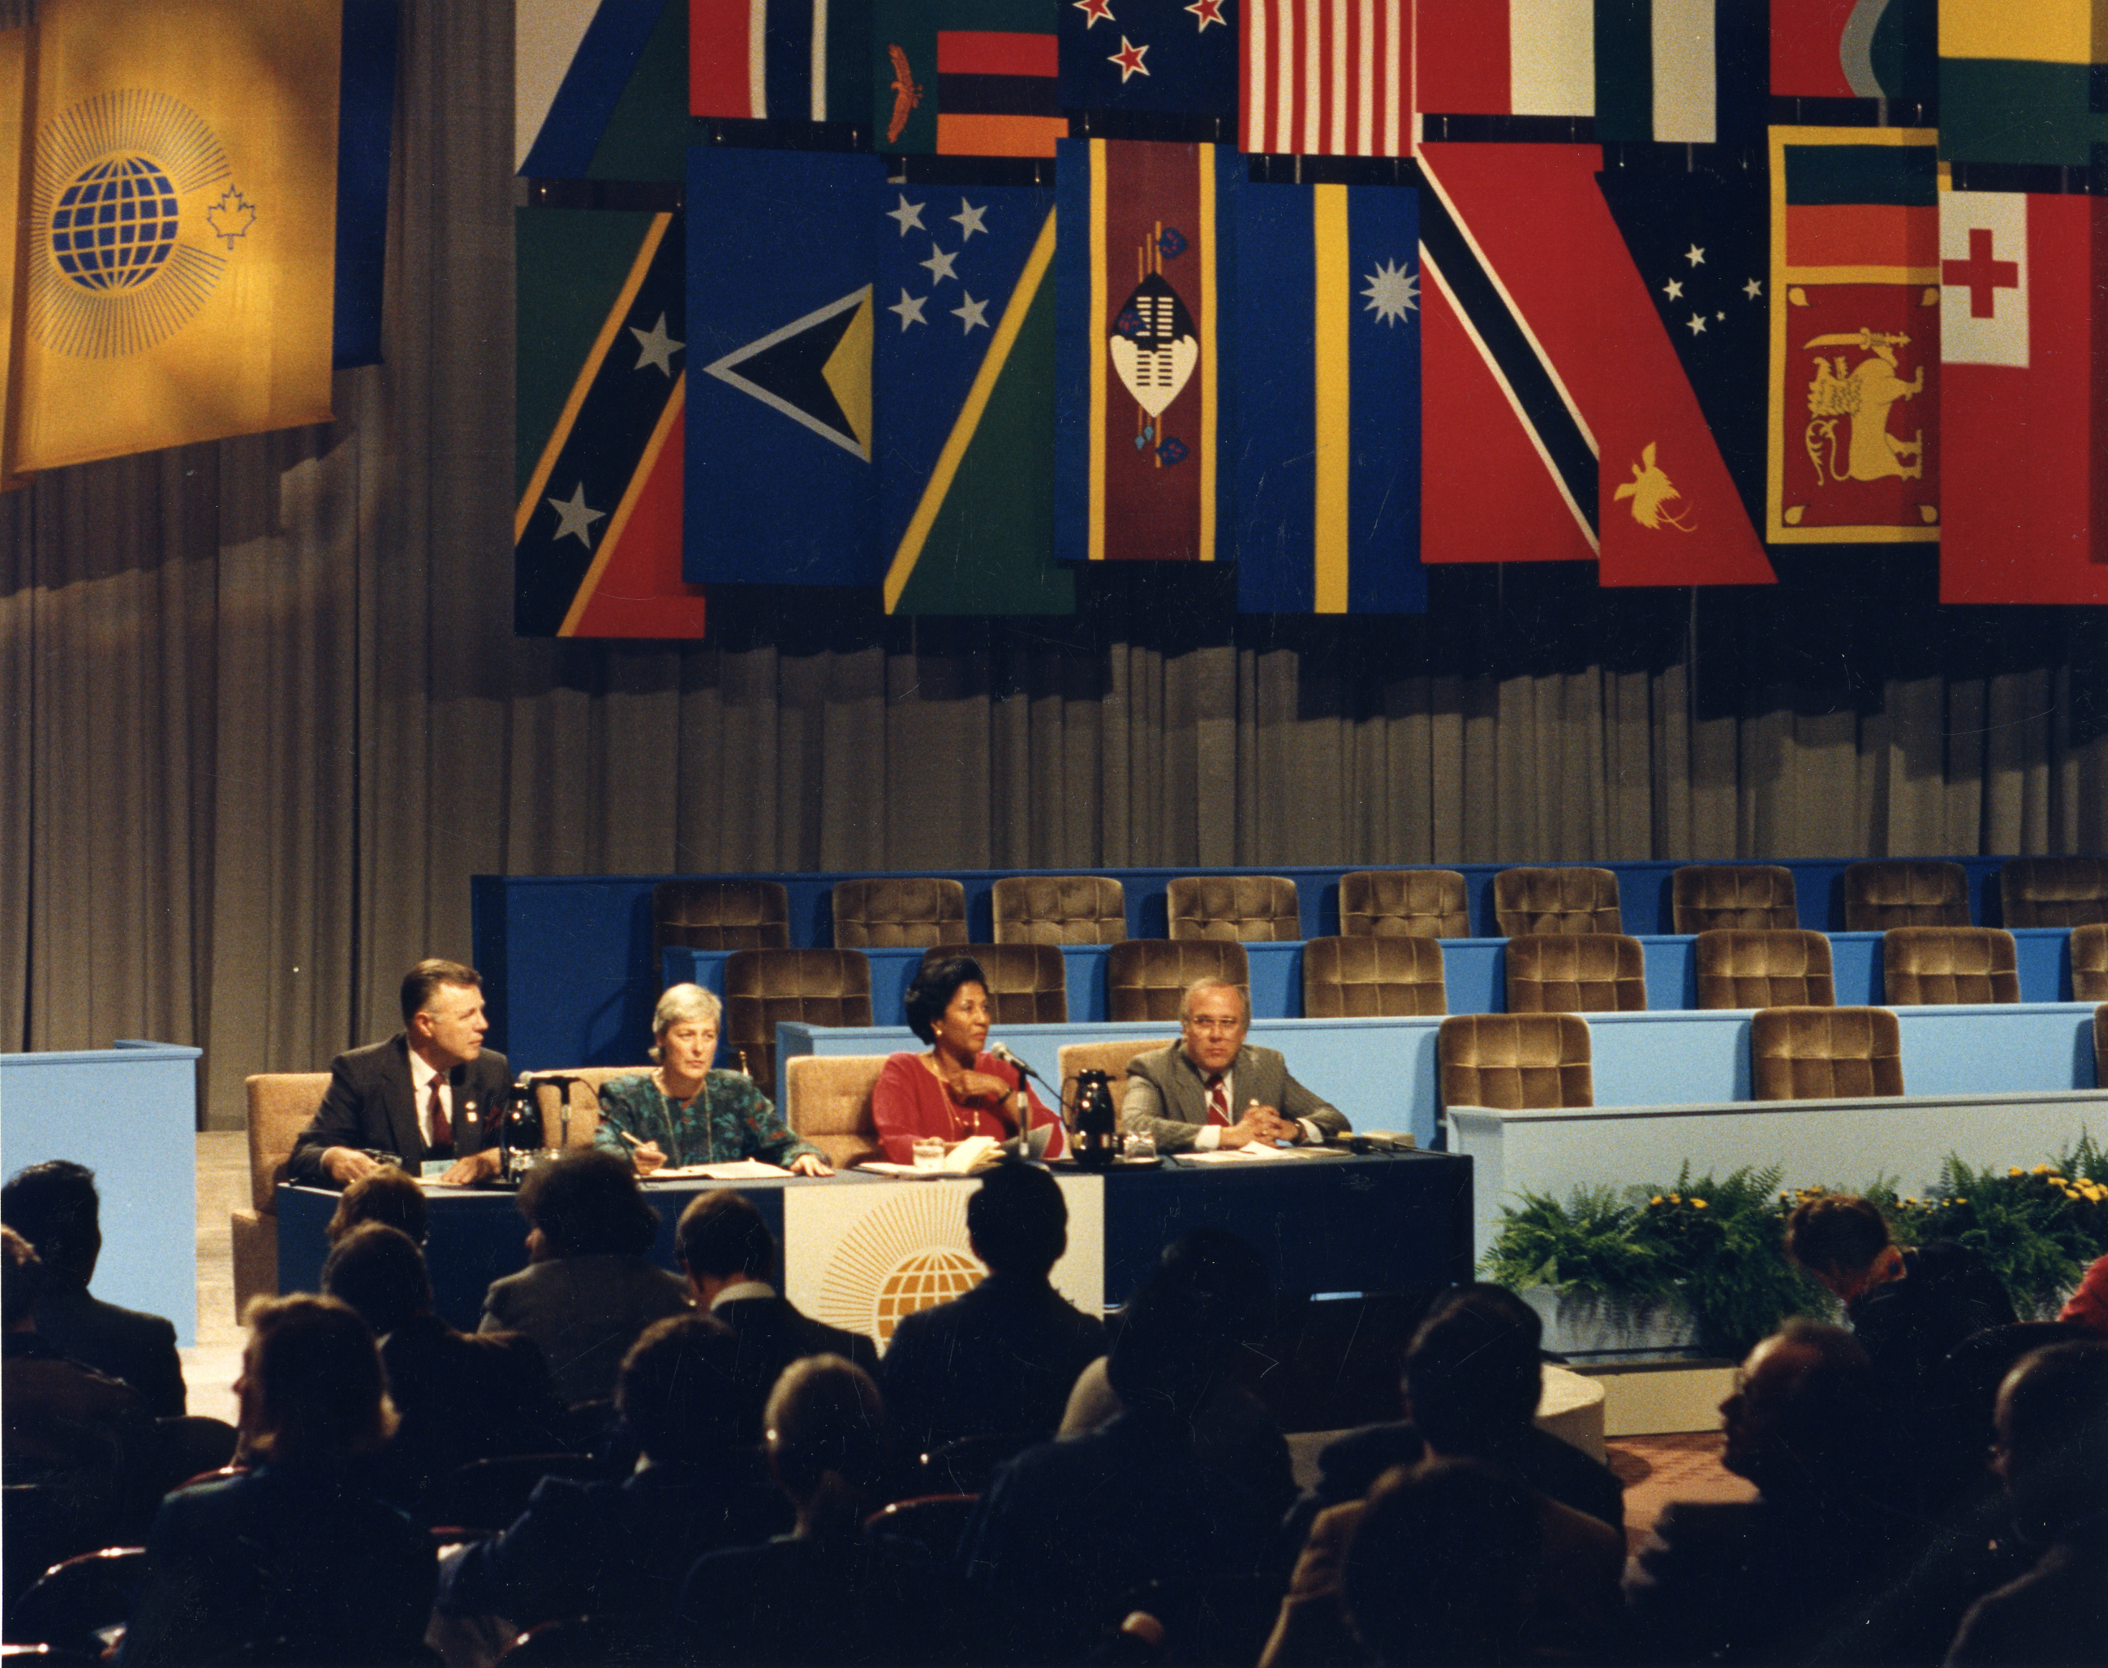

Slide 13
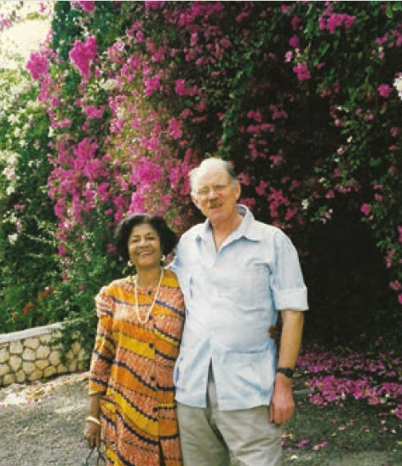
Notes:
x

Slide 14
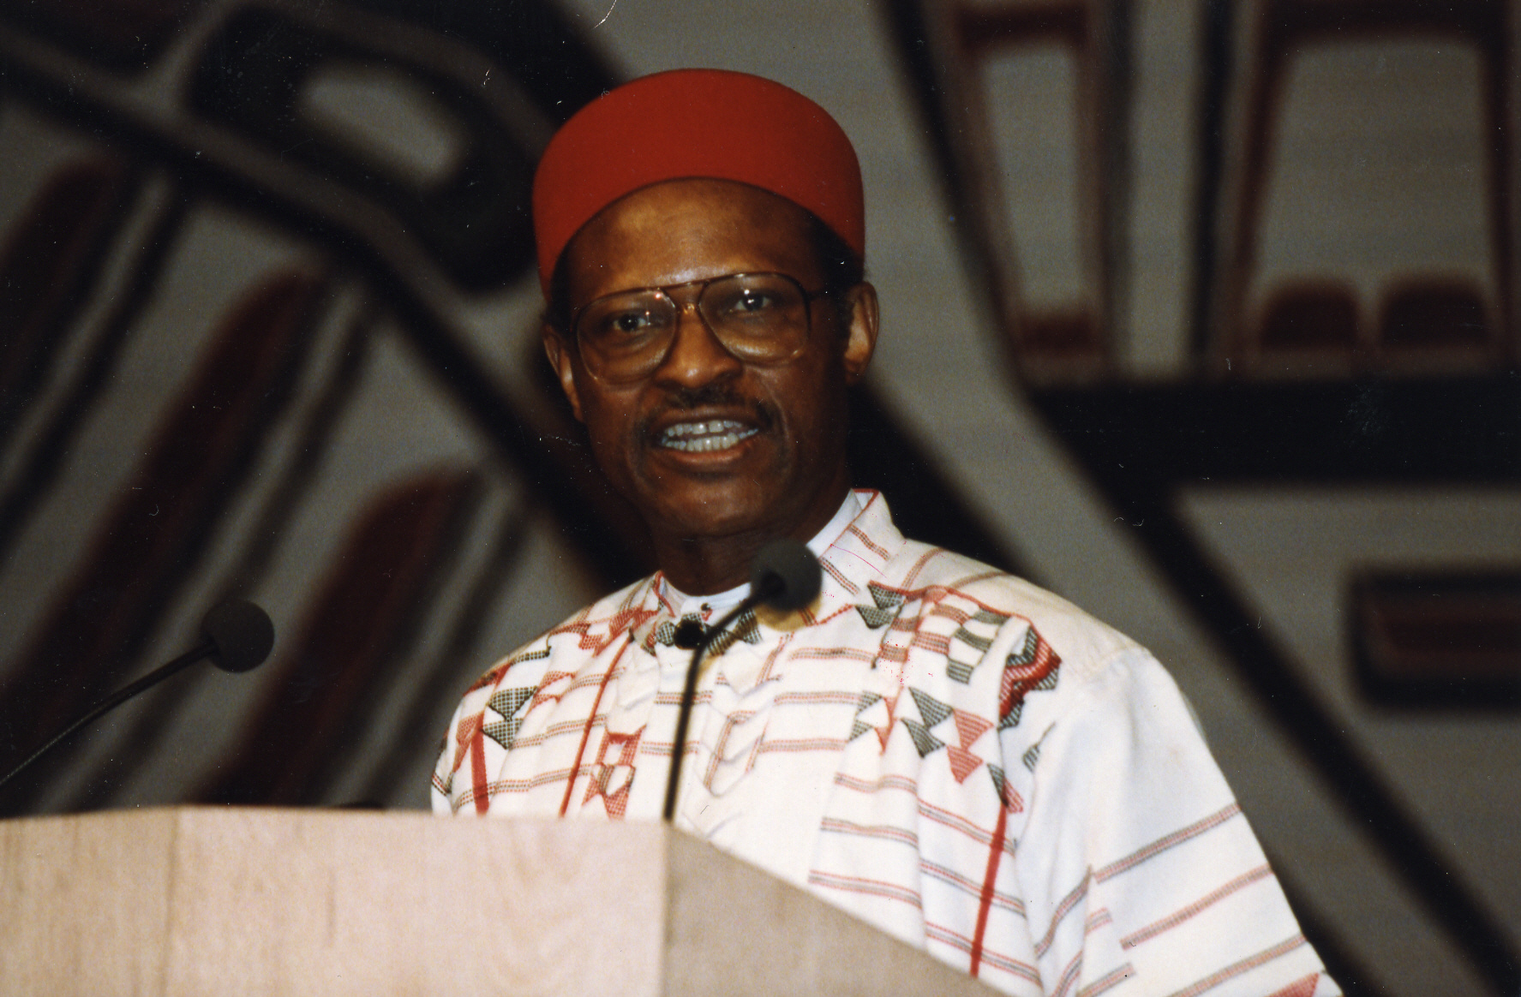
Patsy was not at the conception of the modern Commonwealth but she was at its birth when the Commonwealth Secretariat was established. I first met Patsy in 1966 when I joined the team and we remained colleagues for almost 25 years thereafter. She was a true symbol of the modern Commonwealth who served the organisation with passion and unflinching dedication.
Former Secretary-General
Chief Emeka Anyaoku

Slide 15
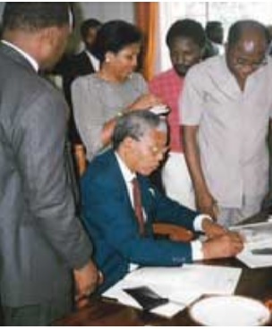

Slide 16
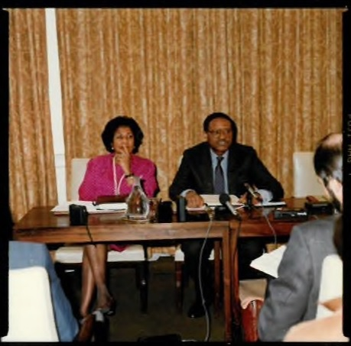

Slide 17
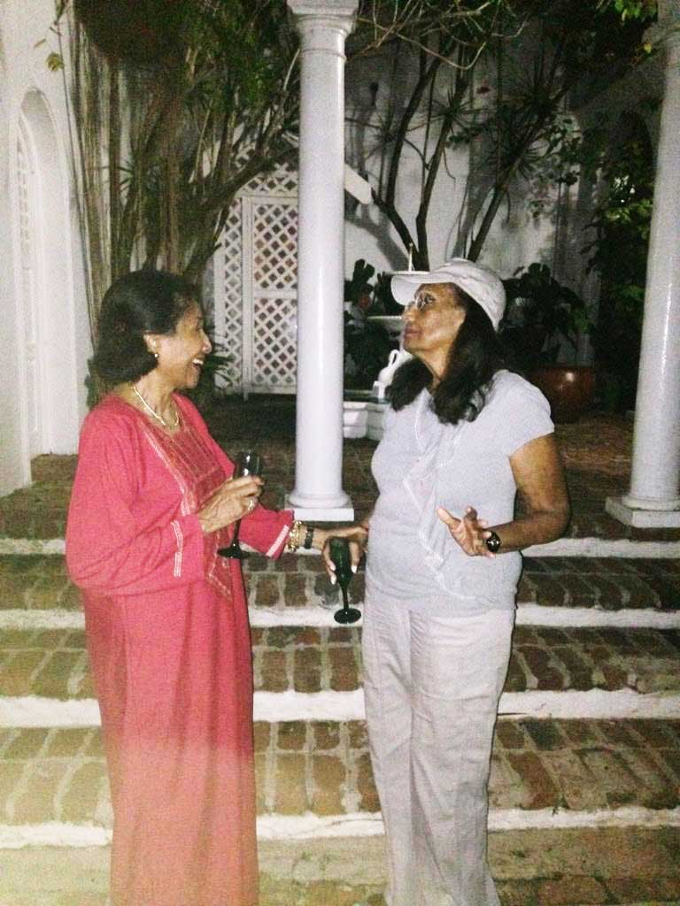

Slide 18
Retirement wasn’t in Patsy’s vocabulary. She was always giving her time and her enthusiastic personality to Commonwealth causes. Where organisations were needed, she founded them - from the Commonwealth Association in 2001, to the Ramphal Institute in 2008. She was a delightful, committed and energetic work partner – and the absolute gracious image of a Commonwealth that extolled racial and gender equality.
Former Secretary-General
Don McKinnon

Slide 19
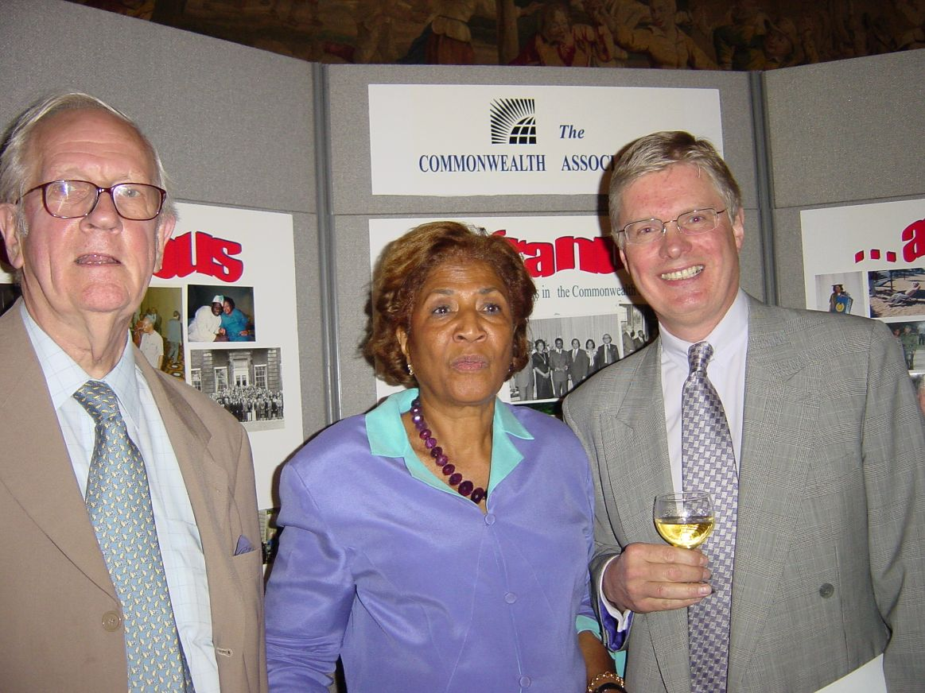

Slide 20
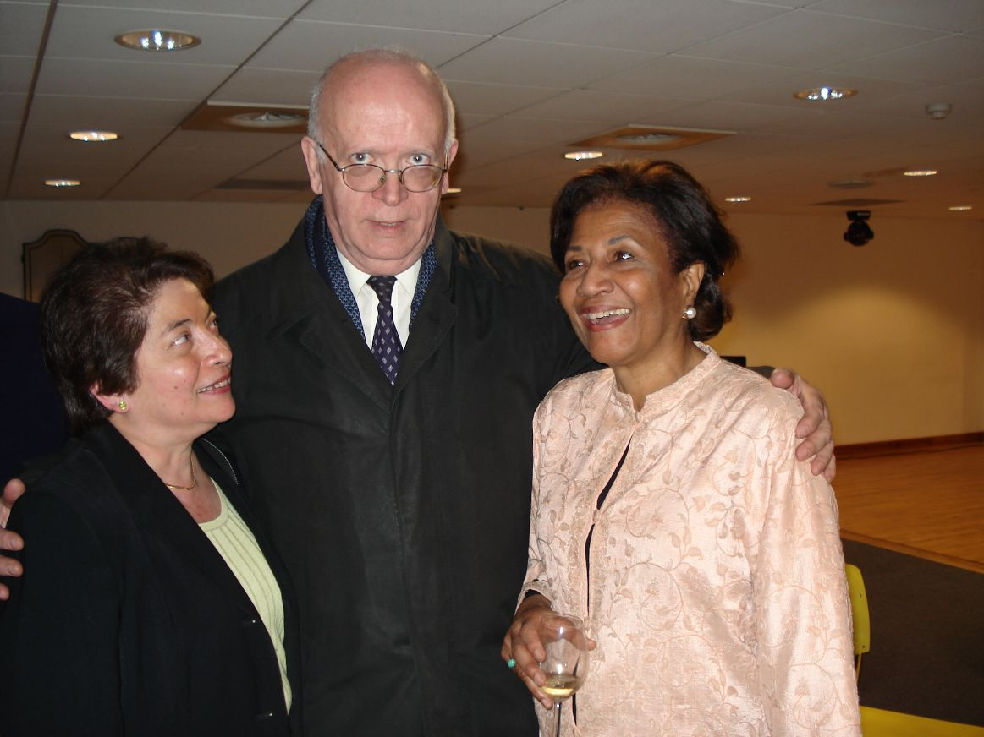

Slide 21
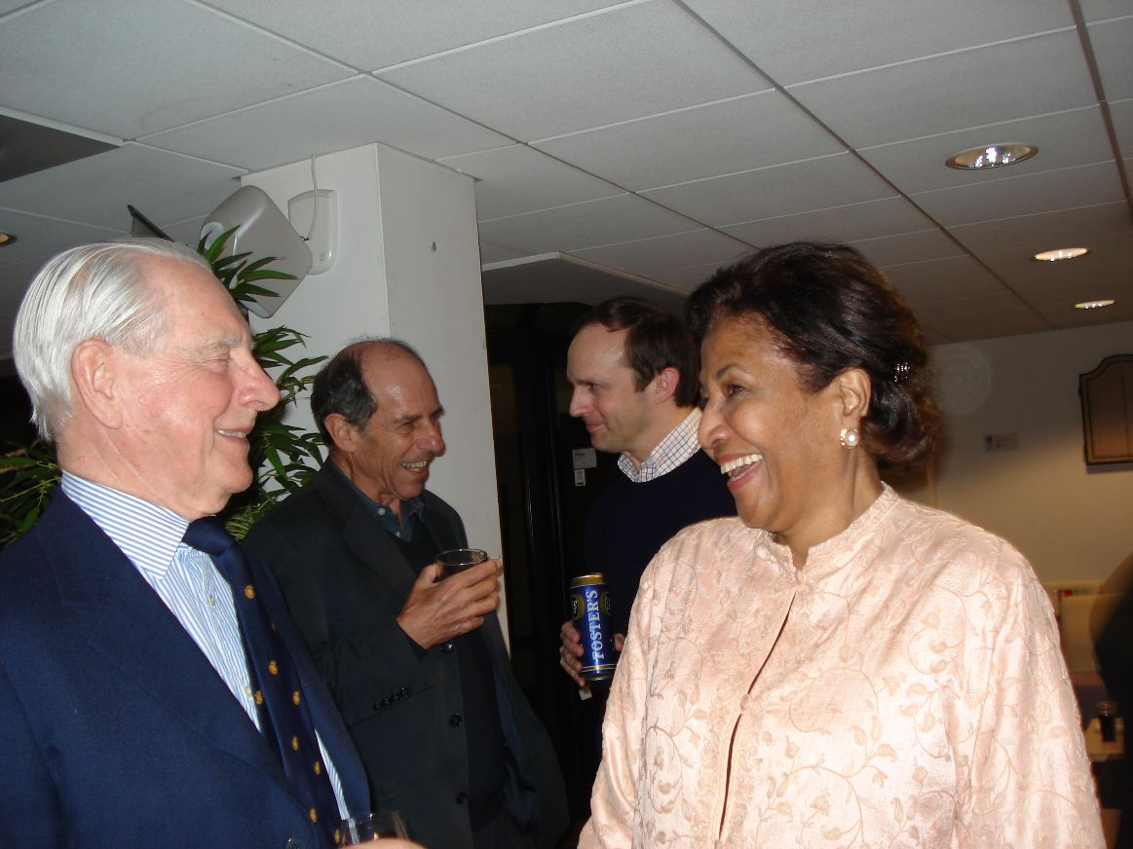

Slide 22
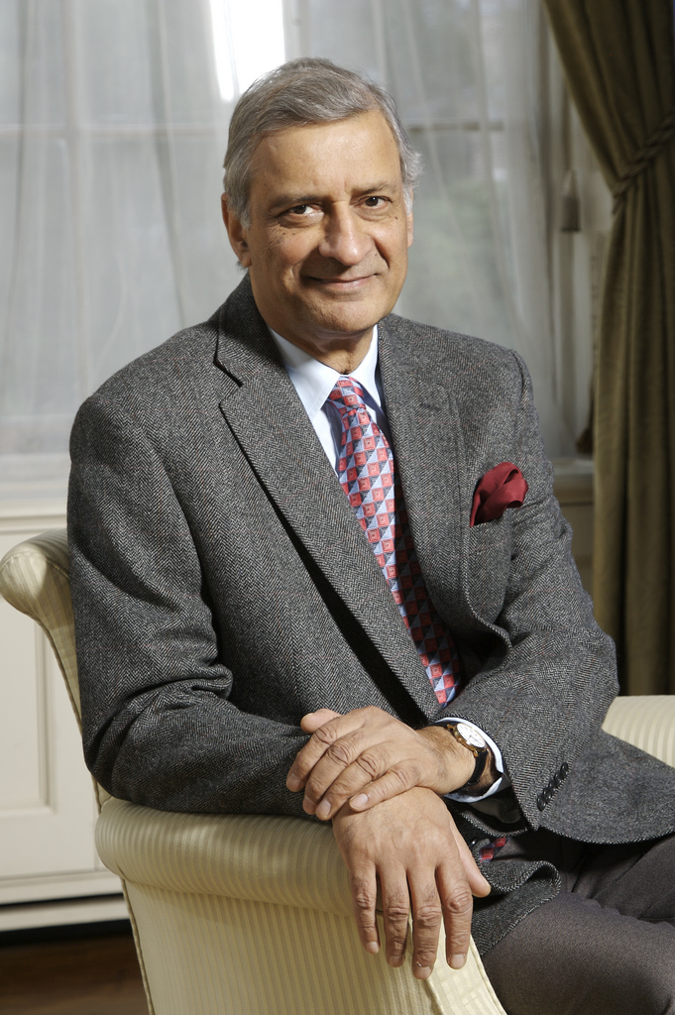
Patsy was an outstanding servant of the Commonwealth and an indefatigable champion of the peoples' Commonwealth, in all its rich diversity. Above all, she recognised that promoting the Commonwealth, and protecting its cherished values, was the responsibility of both member governments and Commonwealth civil society organisations. It was a belief she acted upon, with energy and commitment, until the last.
Former Secretary-General Kamalesh Sharma

Slide 23
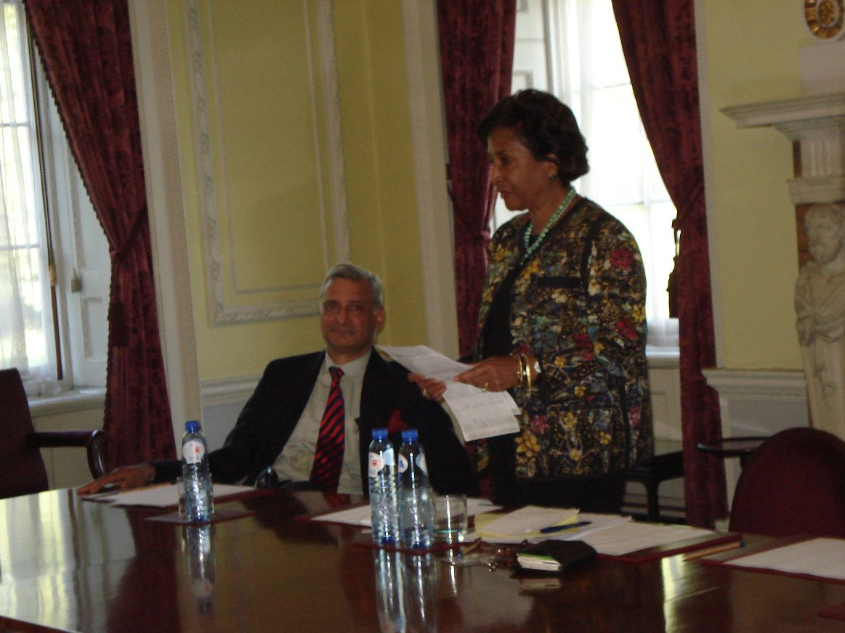

Slide 24
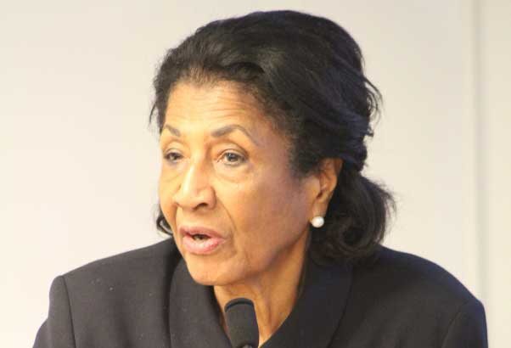

Slide 25
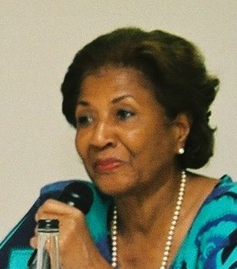

Slide 26
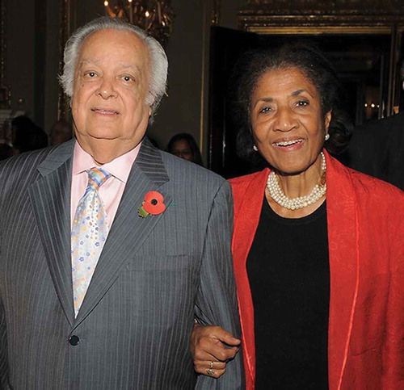

Slide 27
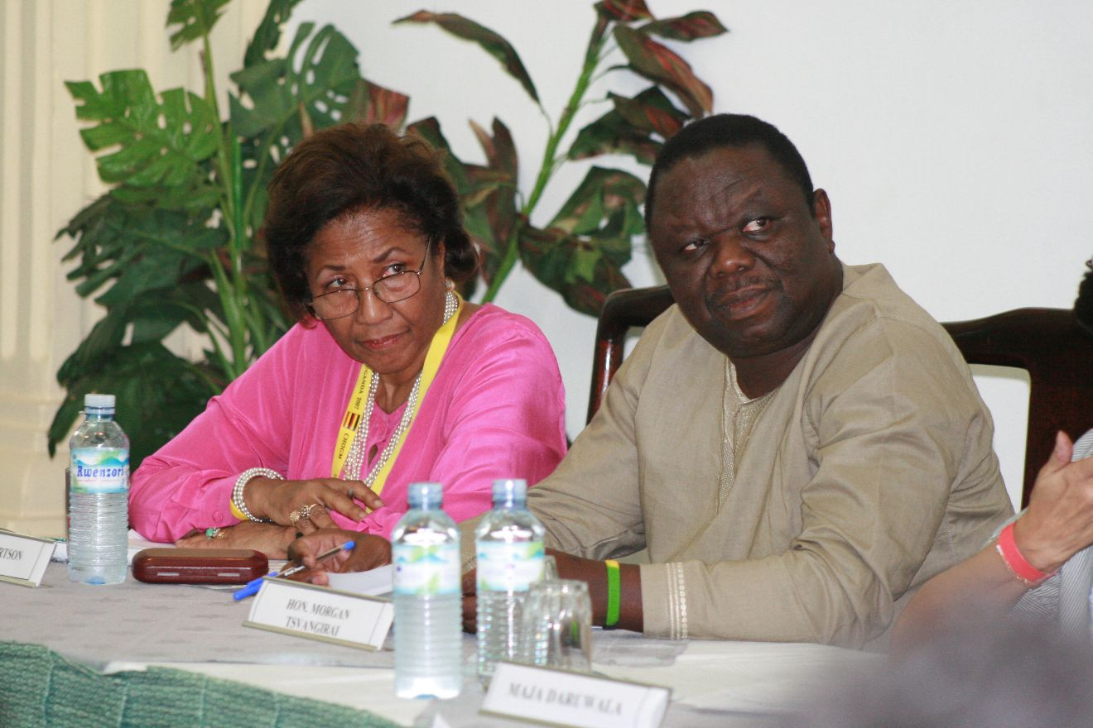

Slide 28
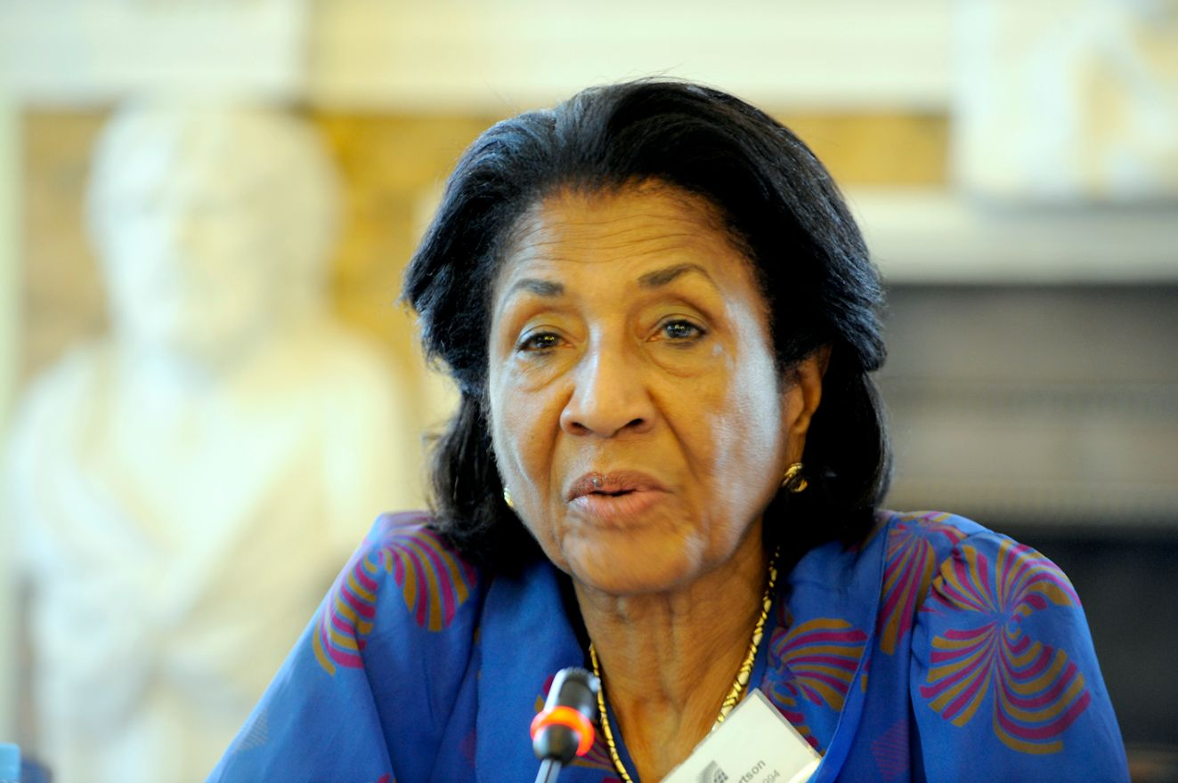

Slide 29
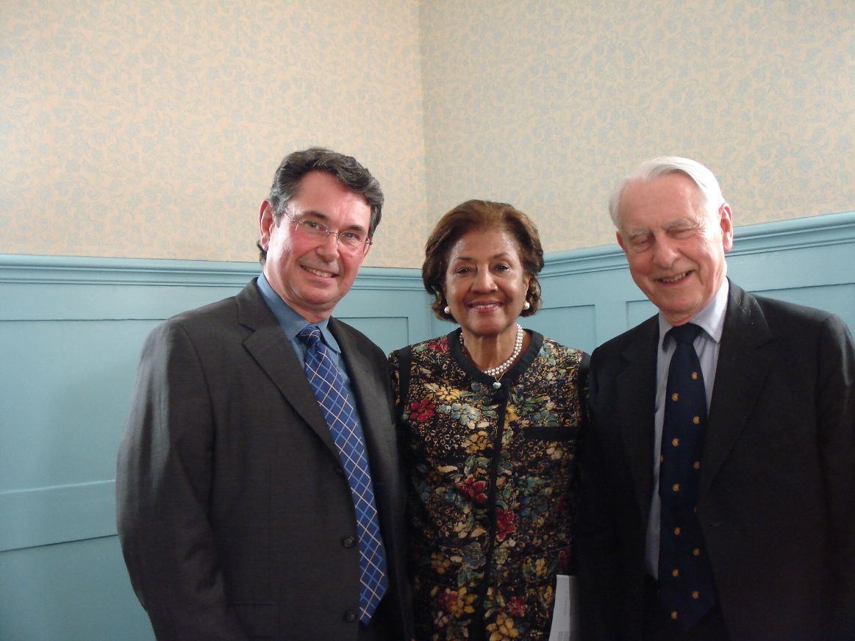
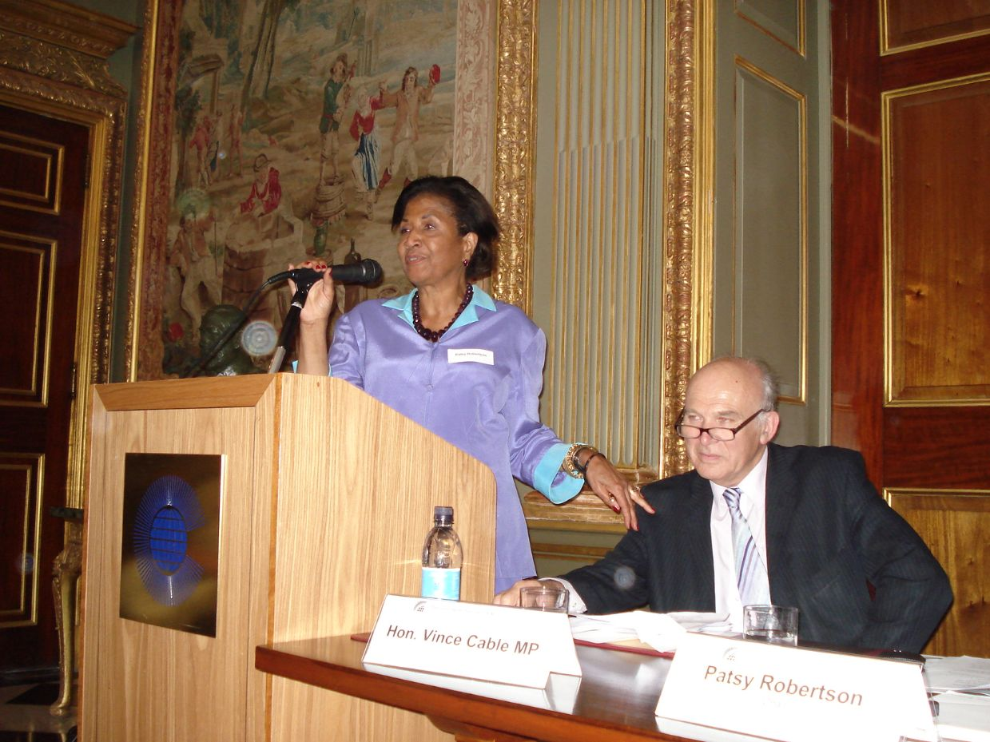

Slide 30
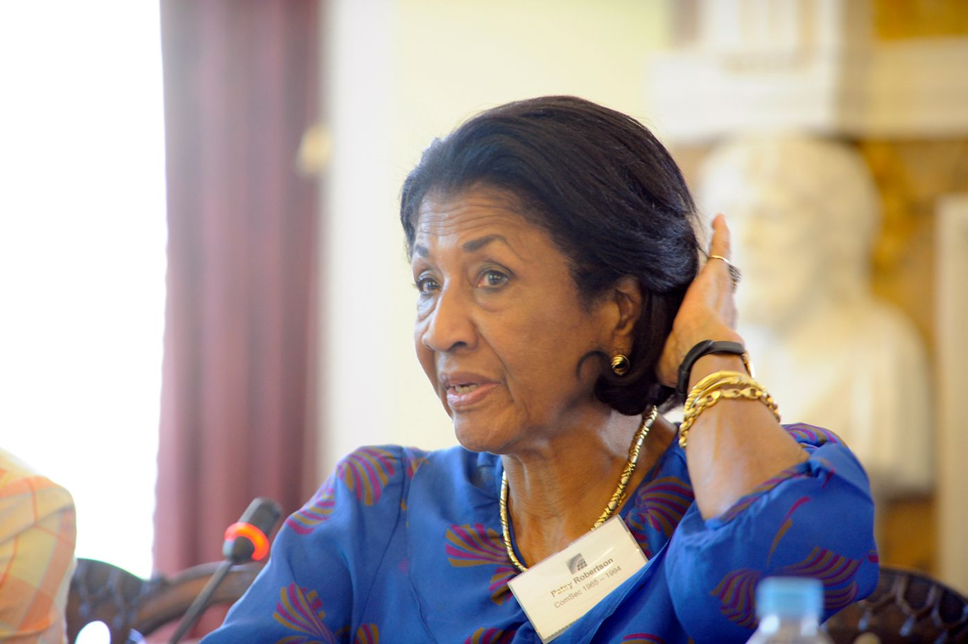

Slide 31
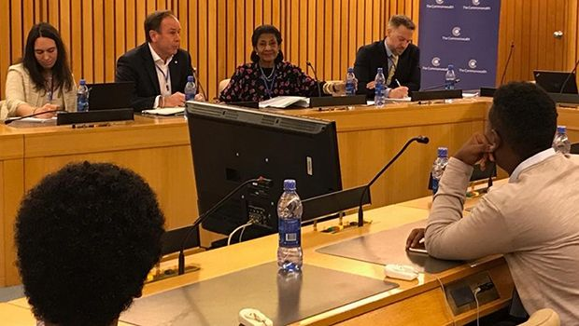

Slide 32
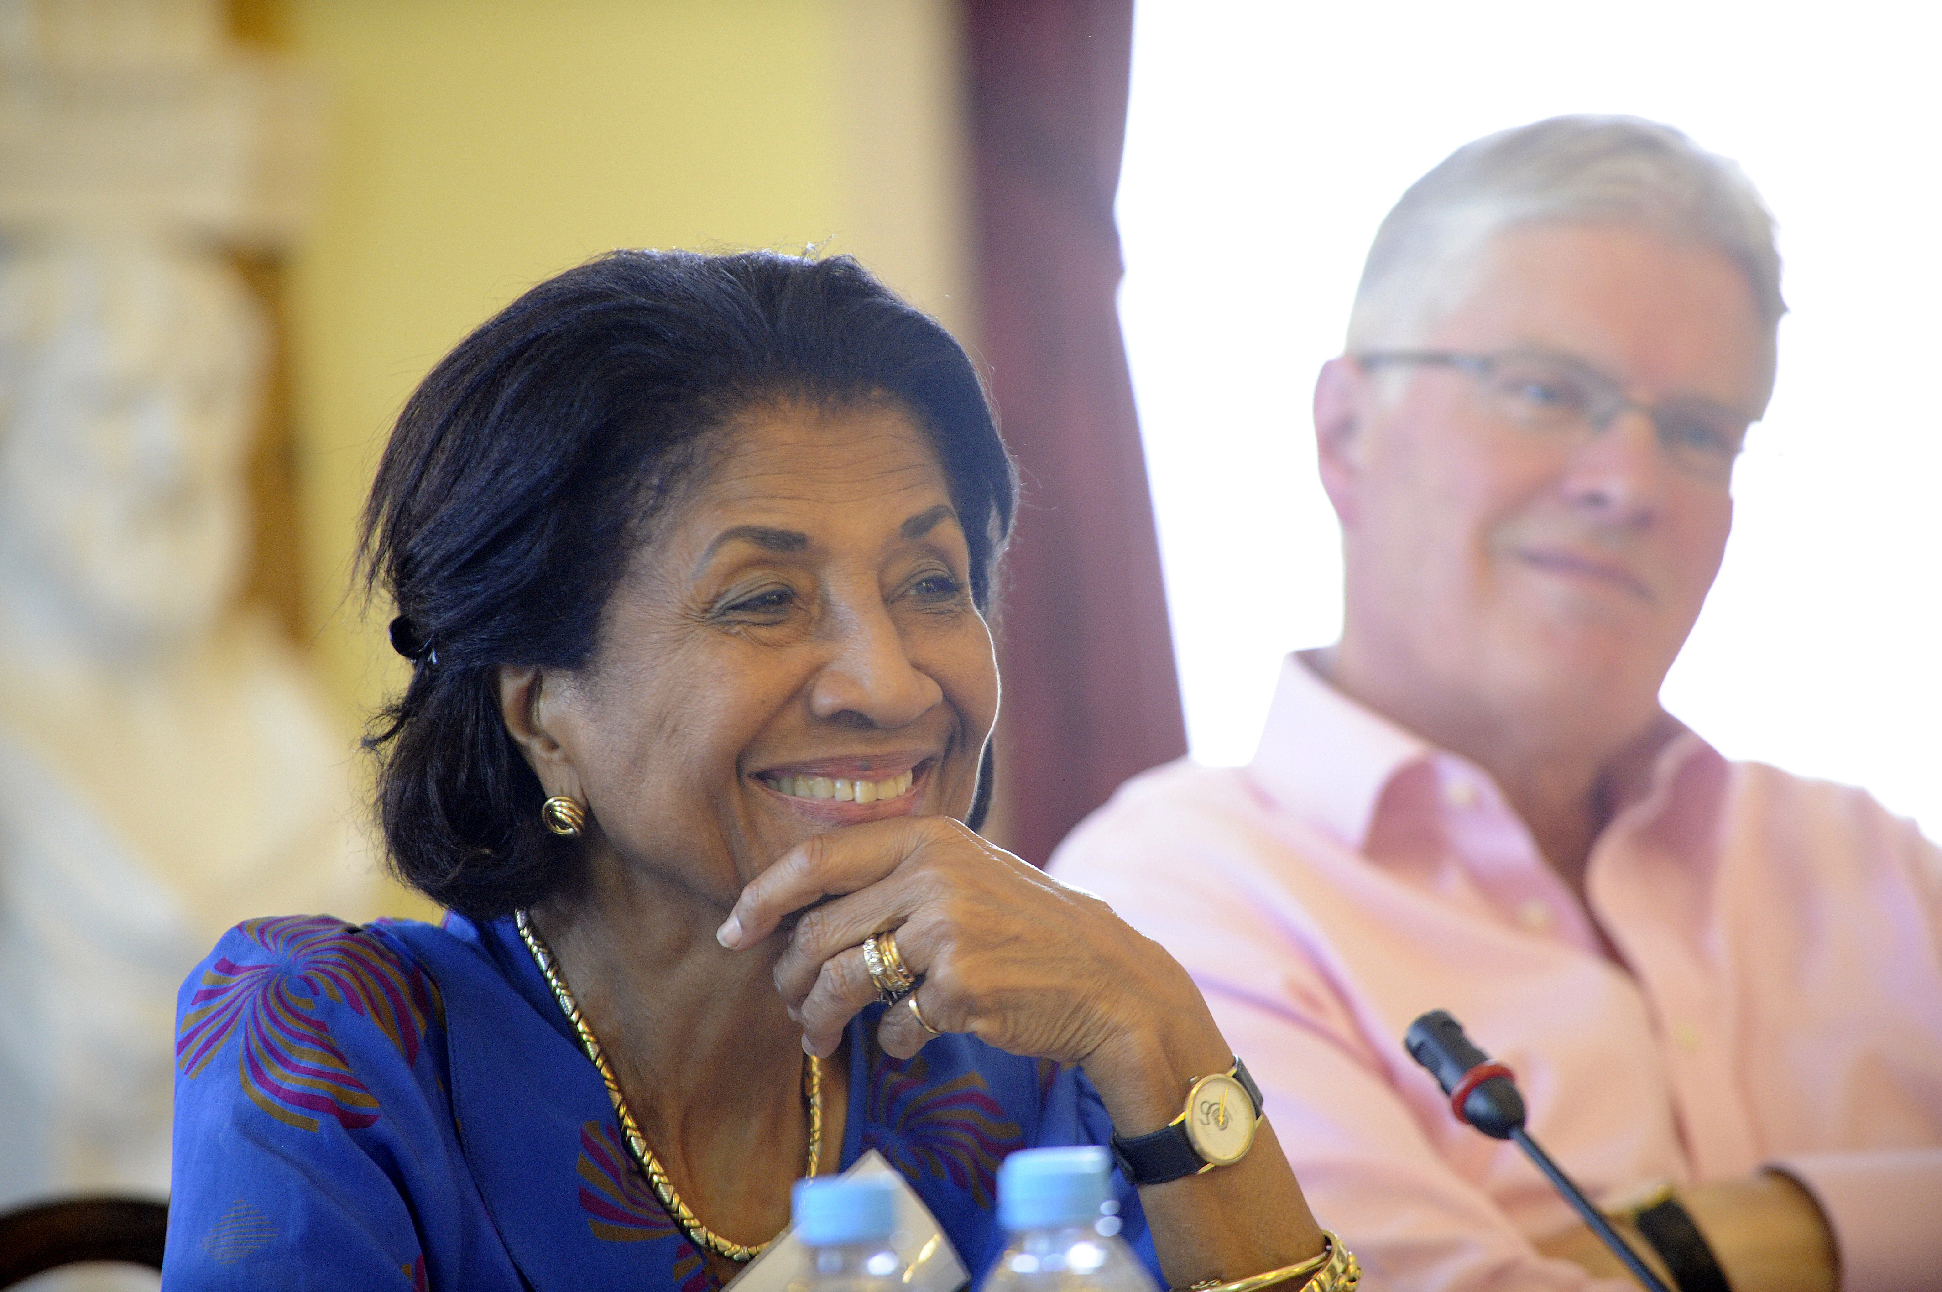

Slide 33
